Slide 1

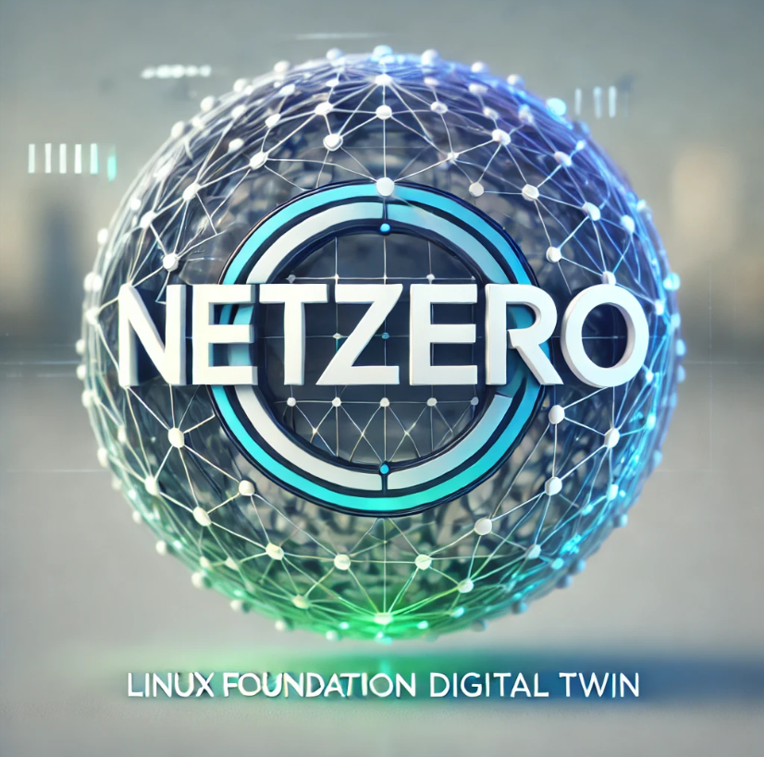
LF Decentralized Trust(LFDT)
Sept 2025
Use of Blockchain Technology
to
Remove Greenhouse Gas Emissions
from
Global Supply Chains
Architecture to develop a Digital Twin for real-time tracking and modeling to Net-Zero greenhouse gas emissions in supply chains.
Special Interest Groups
Supply Chain & Trade Finance / Carbon Action and Accounting / Standards WG

Slide 2
LF Decentralized Trust(LFDT)
Sept 2025
Use of Blockchain Technology
to
Remove Greenhouse Gas Emissions
from
Global Supply Chains
Architecture to develop a Digital Twin for real-time tracking and modeling to Net-Zero greenhouse gas emissions in supply chains.
Special Interest Groups
Supply Chain & Trade Finance / Carbon Action and Accounting / Standards WG

Slide 3
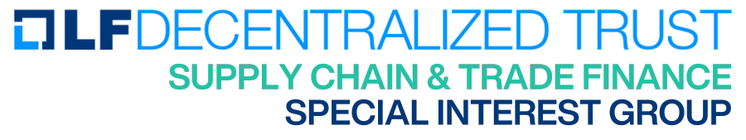

LF Decentralized Trust
Table of Contents
Table of Contents
1
The Climate Challenge and Project Scope
2
What is a Reference Architecture?
3
Project Goals
4
The Global Challenge
5
Commercial Offerings vs. LFDT Platforms
6
LFDT Digital Twin Architecture(technical)
7
Use Case: Digital Twin Pictorial
8
LFDT Technical Architecture(technical)
9
Digital Twin Data Architecture(technical)

Slide 4

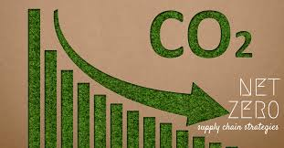
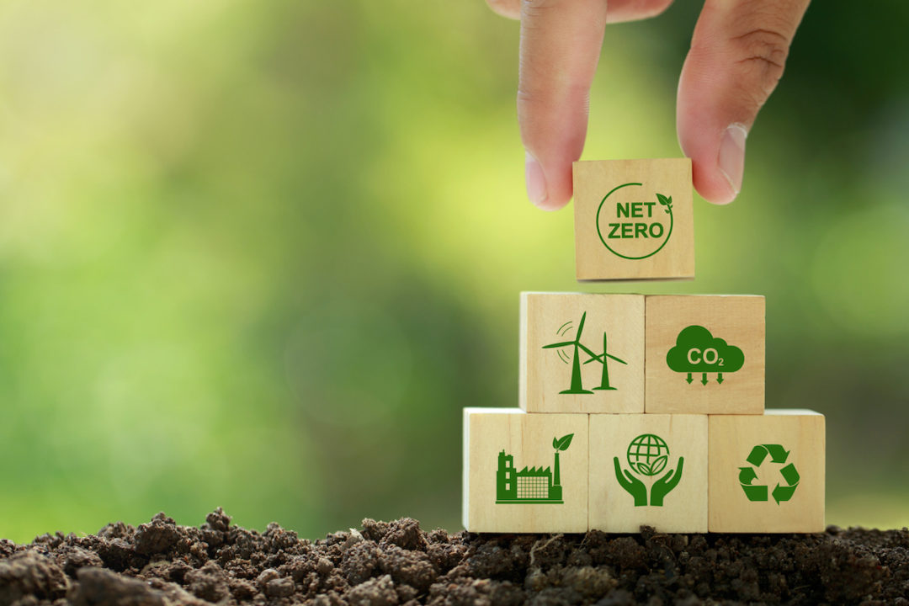

The global challenge for entities is to eliminate GHG emissions in their supply chains……….
The GHG emission challenge is……………
Global government legislation has become more focused on requiring business entities to perform accounting of greenhouse gas (GHG) emissions in their supply chains as a business requirement.
Governments are attaching GHG emissions accounting regulations to imports entering their countries.
Consumers and corporate customers demand sustainability in their business practices focused on GHG reduction.
Inaccurate calculations of GHG emissions in a supply chain can lead to financial and legal consequences, as well as accusations of greenwashing.
The cost of GHG emissions is projected to increase substantially as governments implement net-zero policies.
A LFDT reference architecture providing businesses the ability to plan, conduct real-time monitoring, analyze at a granular level, and optimize supply chain processes related to greenhouse gas emissions DOES NOT EXIST.

Slide 5

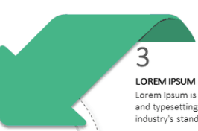







……………..and a solution is to utilize the set of LFDT blockchain platforms and tools.
Deploy LFDT blockchain technologies as the reference architecture for constructing a real time GHG emission tracking platform for supply chains. As a use case, this can include the capability to create a Digital Twin as a tool for modeling scenarios to reduce GHG emissions or to achieve a net-zero footprint.
ee
modular architecture, customizable consensus,
membership services, data privacy features
support for private channels for data privacy
and compliance.
lightweight architecture, ideal choice for IoT and financial applications. Best choice for processing IoT data.
Supply Chain GHG Emission Tracking and Modeling
Indy is a blockchain framework tailored for decentralized identity management. enables trusted interactions without relying on centralized authorities. Aries provides tools, protocols, and libraries to implement verifiable credentials
Lightwe..
An enterprise-grade Ethereum client the offers compatibility with Ethereum tools and smart contracts
LFDT is Linux Foundation Decentralized Trust

Slide 6
What is a Reference Architecture
2
It is a standardized set of applications, tools, and platforms that provides a starting point for designing and developing solutions to business challenges. It offers a generic framework with best practices, common components, and principles that can be customized to suit specific needs.
Example:
Imagine a company wants to build an application to model their supply chain to decrease its GHG emissions
and build capability to track them in real time. Instead of starting from scratch, they can utilize a reference
architecture composed of Linux Foundation platforms and tools that already define common components such as :
Everyone has a reference architecture on their laptops. For example, many use Excel for spreadsheets, Word for word processing and Powerpoint graphics for presentations. There are other options for search word process etc. However, these are the tools you have selected. Project purpose is to be a reference architecture for corporations using blockchain technology for GHG accounting. Businesses and organizations take action on climate change when the process is easier to conduct and less costly.
The objective for this project is to advertise the advantages of using open source software, specifically a portfolio of LFDT platforms and tools, for supply chain decarbonization.
A blockchain implementation - Fabric, Besu, Iroha
Blockchain and data security - Aries
A data transfer (I/O) gateway integration - Fabric
A user authentication service - Indy
The development of this reference architecture can be viewed as an advertisement for Hyperledger Projects

Slide 7
Why this project and Project Goals
From a business solution view detail and promote the advantages of using LFDT systems as a platform for GHG emissions accounting, real-time monitoring of supply chain GHG emissions, and scenario building utilizing a digital twin.
From a solution and technical architecture view detail the advantages of using LFDT platforms and tools and for GHG emissions accounting, real-time monitoring of supply chain emissions, and scenario building.
8,400 companies worldwide report their GHG emissions to various regulatory bodies. Research how these companies report their supply chain emissions and if using a set of technologies, what are these technologies?
To the wider LFDT community, request information on any global companies using LFDT systems for GHG emissions accounting in their supply chains.
Develop use cases referencing companies using LFDT system for carbon / GHG accounting, real-time monitoring, and emission modeling of their supply chains.
1
For the audience, ask them to provide any information they may have on companies using technology for GHG emission tracking.

Slide 8
Project Scope
Based upon LFDT platforms/tools for supply chains, develop a reference architecture for GHG emission accounting and demonstrate a use case focused on a digital twin for modeling supply chain emission scenarios.
Promote LFDT platforms/tools as the premier products for GHG emission accounting and reporting.
Communicate concepts of a reference architecture and digital twin.
Create a use-case demonstrating how LFDT platforms/tools are the premier software for real-time tracking of GHG emissions and construction of a digital twin.
Define all LFDT components needed for a supply chain digital twin.
Demonstrate the use of the LFDT Standards Working Group data ontology.
What is not in scope
Modeling mitigation opportunities (MAC curves).
Producing an operational digital twin.
Determining costs associated with producing an operating digital twin. Note: Kaleido has a cost.
Any non-LFDT products as a portion of the physical digital twin.
1
LFDT – Linux Foundation Decentralized Trust

Slide 9

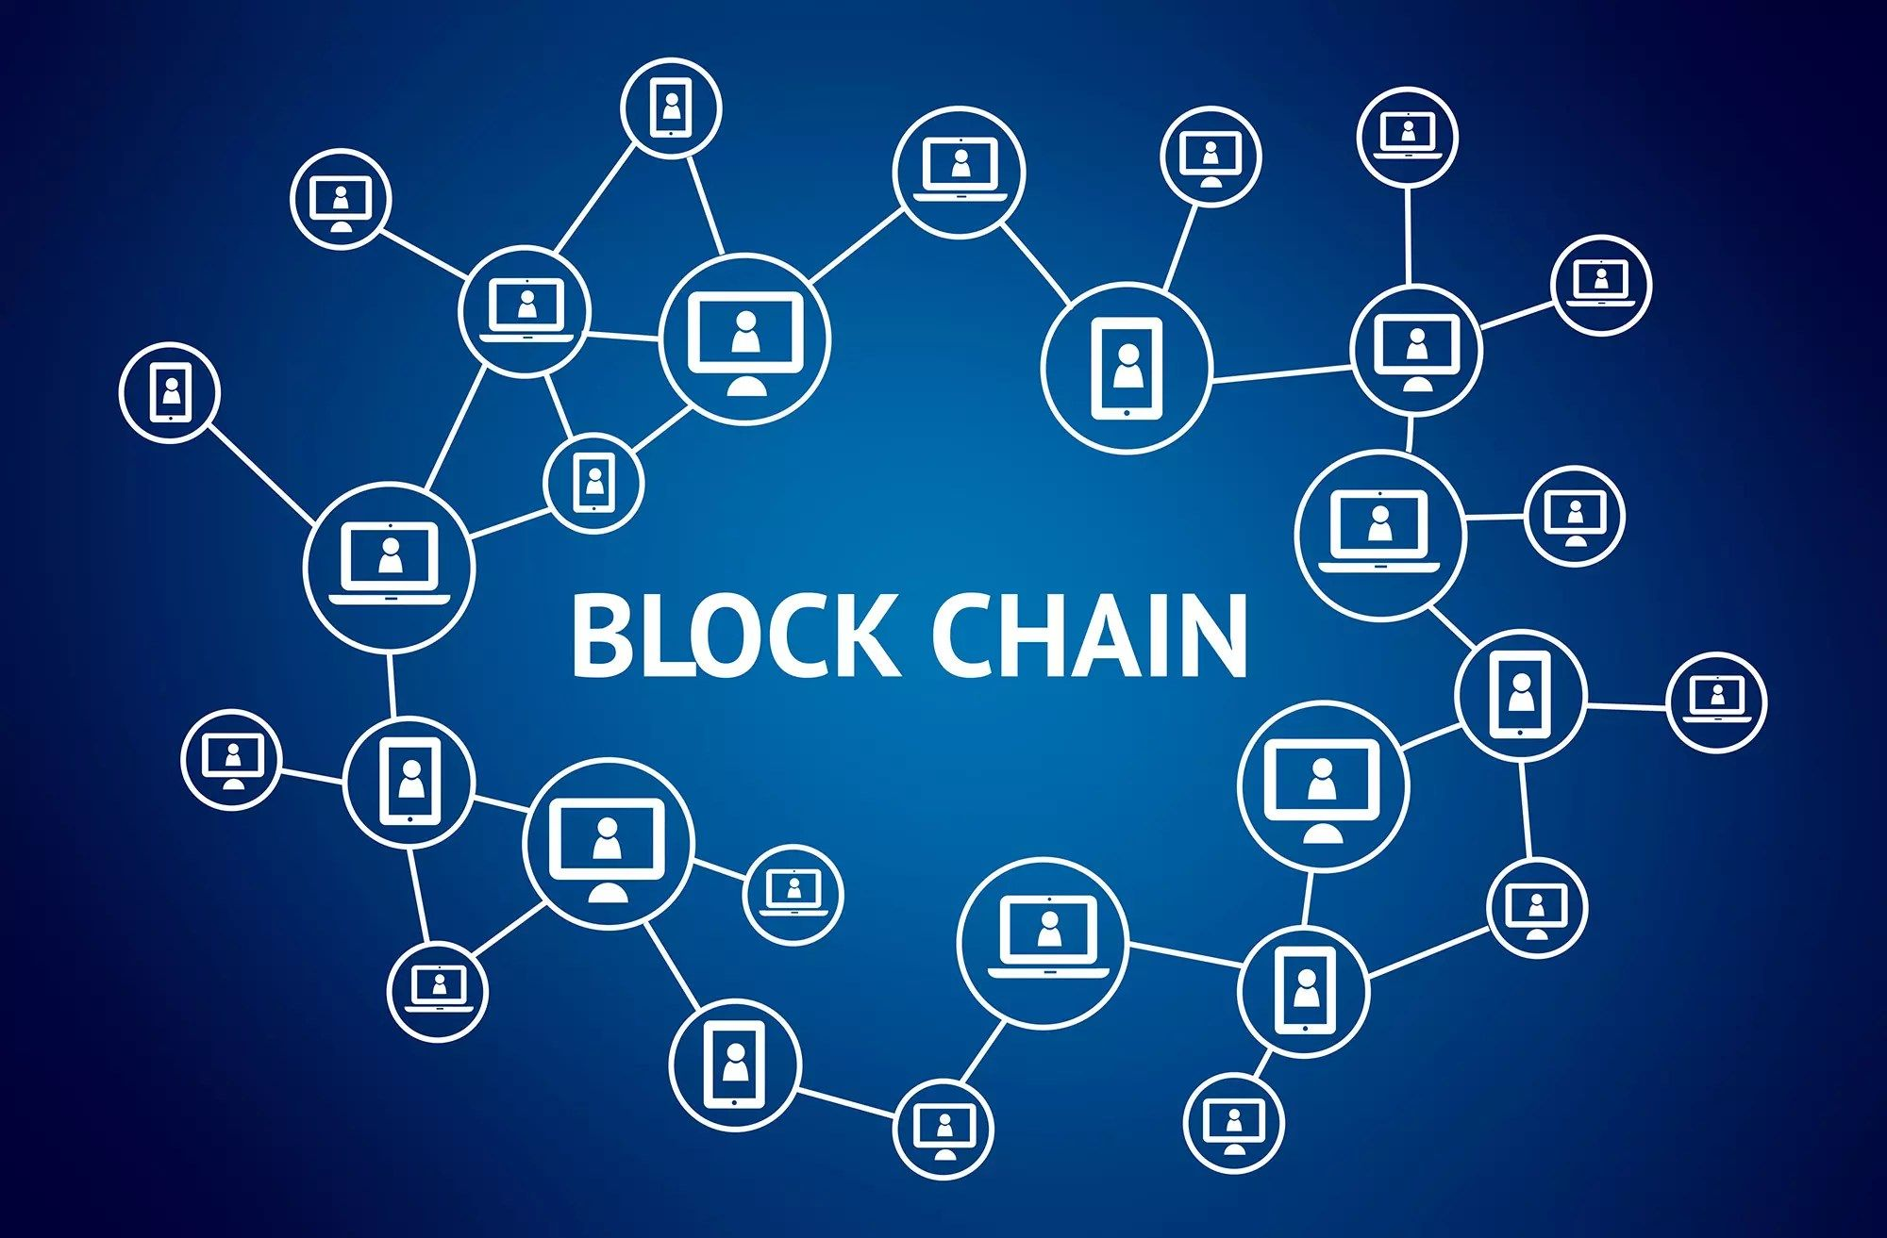
Commercial Offerings
For
GHG Emissions
Accounting Systems
Digital Twin Deployments

Slide 10
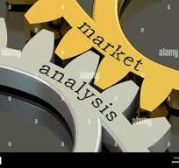
A Short Historical Perspective on the Use of Digital Twins
A Digital Twin is not a novel idea. Although it has long been used in digital simulations in fields like
manufacturing, aircraft, and the car industry, its use in modelling our environment has only recently been viewed as a important use case.
The use of digital models of assets to provide simulations and an information link to a real-world entity (i.e., a physical twin) is one recent interpretation of the "Digital Twin" concept in the built environment research.
Historically used in industries like manufacturing, aerospace, and automotive.
Adoption is more recent in sectors like construction, infrastructure, and real estate. Source: Parmar, Leiponen, & Thomas (2020).
Focuses on digital models that simulate and connect with a physical asset (the “physical twin”).
Enables real-time feedback and analysis.
Enables data-driven decision making
Supports asset operations and management through better insights and analytics.Source: Brilakis et al. (2020).
Core concept: linkage between physical and virtual objects achieved through a continuous data
connection.
Digital Twins are use-case dependent
No one-size-fits-all approach—configurations vary widely based on application needs.

Slide 11



Brief overview of the market deploying GHG emission accounting systems.
Workiva has not developed a specific digital twin solution for carbon accounting. However, it offers Workiva Carbon, an integrated platform designed to streamline carbon accounting, carbon management, and decarbonization efforts. This solution helps organizations monitor and report greenhouse gas emissions across their operations, including Scope 1, 2, and 3 emissions, by gathering real-time data from ERP systems, accounting platforms, and utility providers.
Notes : Markets a platform with substantial functionality including development of a carbon emission baselines, categorize data for multiple reporting frameworks and identify and prioritize carbon reduction or offset plans to reach sustainability goals. Software platform is unknown.
The Digital Twin Consortium (DTC) is actively involved in carbon accounting initiatives, particularly focusing on the building industry. Their efforts leverage digital twins to help building owners, operators, and stakeholders assess, manage, and reduce both operational and embodied carbon emissions throughout the lifecycle of buildings. DTC emphasizes the role of digital twins in enabling data-driven insights and real-time decision-making, which are crucial for optimizing building performance and aligning with sustainability and net-zero carbon goals.
Notes : Focus is on emissions from buildings using digital twins. There is no capability advertised or communicated for modeling/scenario building to reduce or eliminate GHG emissions as it applies to supply chains. Fit is for a single purpose.
Constellation Navigator offers a carbon accounting platform designed to help businesses track, report, and reduce their greenhouse gas (GHG) emissions. This solution integrates data ingestion, scenario analysis, and reporting capabilities to provide transparency across Scope 1, 2, and 3 emissions, aligned with multiple sustainability frameworks. It aims to simplify the collection of emissions data from diverse sources like utility bills, streamline reporting, and support businesses in setting and achieving their climate targets.
Notes : While the platform addresses challenges such as scattered data and complex calculations, it does not explicitly mention the use of digital twins. the service focuses heavily on real-time data analytics and decision-making tools that align with many goals of digital twin technology—such as providing visibility into operational footprints and enabling proactive sustainability management.
Information presented is state of the market on 10.15.2024

Slide 12


Brief overview of the market deploying GHG emission accounting systems.
Platform to aggregate , sort and filter emissions data. Functionality to compare emission source and resource consumption to identify trends, patterns and emission hotspots. Data integration consists of uploads of emission data – no API for real time tracking of emissions. Large tool set for computing the cost of decarbonization in marginal abatement cost curves(MAC curves). Calculate and compare costs of mitigation options that are too costly to be reduced internally. Collects scope 1, 2, 3 emissions. Compare and contrast marginal abatement costs of mitigation options across multiple business units.
Microsoft Sustainability Cloud
With a suite of ESG (environmental, social, and governance) tools, it is designed to empower organizations in accelerating their sustainability initiatives and driving business growth through the power of data and AI. With features like Microsoft Sustainability Manager, users can drive data transparency and insights to take actionable steps.
Microsoft's Sustainability Cloud already has a series of heavy-hitting partnerships. The Sustainability Cloud interprets data from the whole spectrum of ESG, which may impact the granularity of its carbon accounting data and subsequent insights it may be able to provide. It may lend itself more to the mid-market/SMB customer, but it is too early to tell.
Net Zero Cloud – Salesforce
Emissions accounting product built on Salesforce's automation, language support, and integration features. While this can be a strength and lend itself to useful emissions reporting features, it also comes with limitations due to its reliance on its existing data schema, which wasn't built for accounting. Net Zero Cloud does come with a robust list of partners like Accenture and several others in the enterprise space. While there have been mixed reports on the overall scalability of the tool, its dashboard functionality is solid.
IBM Environmental Intelligence Suite
IBM Environmental Intelligence Suite is mostly legacy software aimed at managing swaths of data. As an emissions management solution, it offers basic climate risk analytics with the help of IBM AI capabilities.
A large part of IBM’s offering is focused on risk analysis and response efforts. Its features help organizations monitor disruptive climate conditions as it aims to operationalize carbon accounting
Information presented is state of the market on 10.15.2024

Slide 13
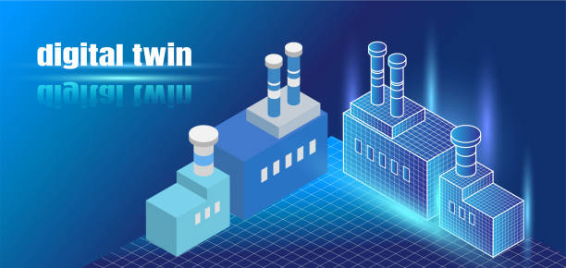
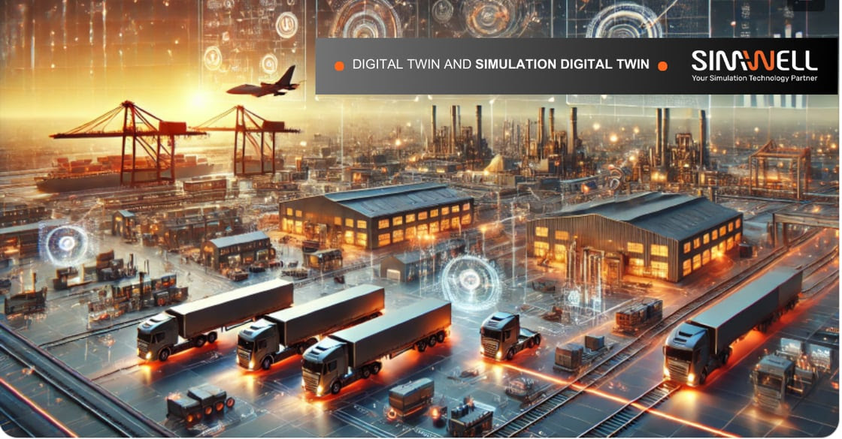
Market overview
Seize the Future: Digital Twins Driving a More Agile 2025 and Beyond
As an example of the advantages for using a digital twin for monitoring supply chain operations is the company SIMWELL. This firm markets its capability to develop and deploy commercial digital twins for simulation, optimization, and modeling for supply chains.
SIMWELL has a value statement for the use of digital twins in an ever changing business environment where tariffs are imposed:
When Tariffs Strike: Essential Questions to Guide Decisions
Can I still serve U.S. clients from Canadian plants profitably?
How do I optimize routes and sourcing to offset tariff costs?
If I must cancel orders or prioritize customers, who gets served first?
Do I need to impose constraints on how I serve clients?
Should I diversify my supply base or shift production to other regions to reduce risk?
Can I renegotiate contracts or terms to better align with the new tariff landscape?
NOTES:
Simwell does not collect data in real time.
The Simwell solution is focused on economics – GHG emissions.
It is no longer enough to rely on static models and gut instincts to determine GHG emission totals
in future operations yet, Simwell does not address GHG emissions accounting.
simwell.io

Slide 14
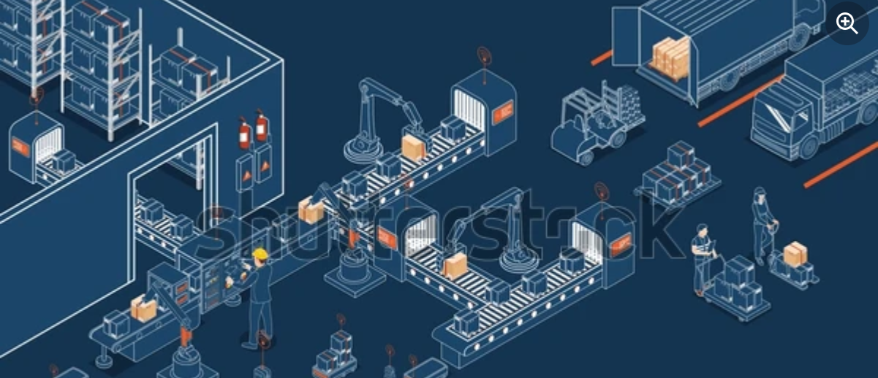
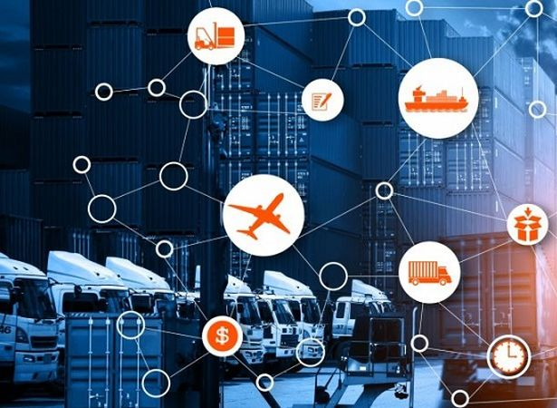
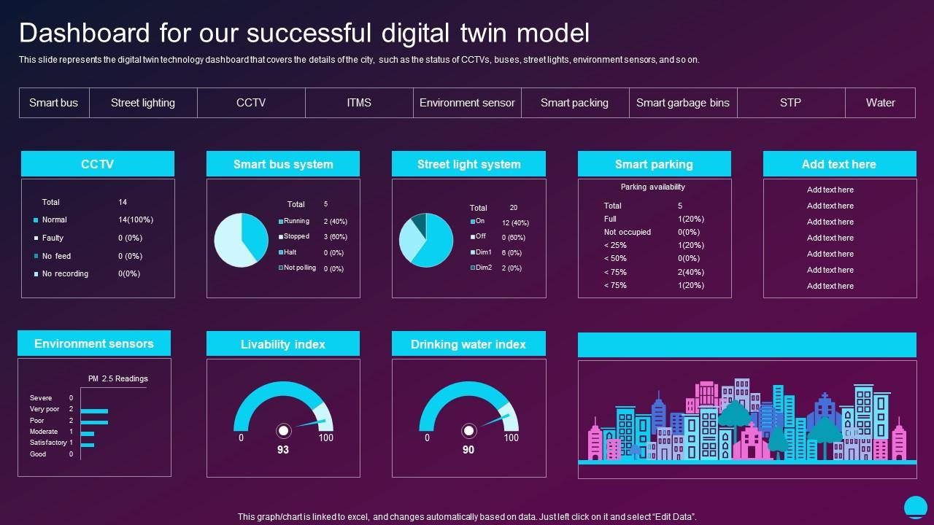

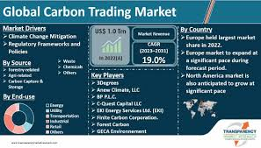
Stepping Up: The Simulation Digital Twin Advantage
Digital twins offer several advantages across industries, primarily by creating virtual replicas of physical objects, processes, or systems. These replicas help organizations optimize performance, improve decision-making, and reduce costs.
The benefits of a Digital Twin for GHG emissions accounting and supply chain modeled scenarios:
Real-Time Monitoring - Digital twins provide functionality for real-time emission monitoring on the assets within a supply chain.
Simulation - By simulating various emission scenarios within the digital twin, companies can demonstrate to their partners how changes to their supply chain can reduce emissions prior to any actual changes.
Improved Decision-Making through Data Insights - Digital twins collect and aggregate data from IoT devices and other sources providing actionable insights. This data-driven approach facilitates faster decision-making, especially for complex systems such as supply chains​, where changes to operations can occur in real-time to prevent deviation from emission baselines.
Emission Baseline Design – A digital twin enables GHG emissions experts to determine a realistic approach for the reduction of GHG emissions using the SB…approach and strategize with supply chain partners.
GHG Emission Accounting – If needed, GHG emission counting functionality can be added to a Digital Twin
Scenario Simulation for Risk Management - Organizations can run simulations for various scenarios (e.g., natural disasters, supply chain disruptions) to identify potential risks and develop mitigation strategies. .
Measuring and Actions in Supply Chains
The contents of this slide were collected from openAI responses to questions centered on the advantages of digital twins.

Slide 15
Advantages
of
LFDT Blockchain and Related Platforms
to Architect a
Digital Twin

Slide 16
Issues Developing and Deploying a Digital Twin
The GHG emission challenge is……………
These challenges range from data integration and system interoperability to high implementation costs and organizational resistance, often complicating successful adoption.
Issue - High initial investment: Implementing a digital twin can require significant upfront costs for hardware, software, and expertise.
Solution: LFDT platforms offer a cost effective modular and customizable architecture, allowing businesses to tailor blockchain
solutions to their specific needs while ensuring scalability and performance.
Issue - Need for real-time Data Processing: Real-time data is essential for digital twins, but processing it fast and effectively requires a strong IT infrastructure, which presents a challenge for some businesses.
Solution: LFDT platforms are best choice for processing large volumes of GHG emission IoT data through Fabric channels and Iroha.
Issue - Systems Integration: Digital twins are not isolated entities. They must integrate with current technology and systems. Because it frequently entails integrating new software with historical systems that weren't intended to communicate with one another.
Solution: LFDT platforms facilitate seamless systems integration by offering interoperable frameworks and tools that connect diverse
technologies and data sources within a permissioned blockchain network.
Issue - Data Protection: Sensitive data associated with a digital twin may need additional security measures.
Solution: With advanced cryptographic techniques and tamper-resistant ledgers, LFDT platforms provide robust security, safeguarding
data integrity and confidentiality in enterprise applications.
Issue - No universal framework: There is currently no standardized approach to building and managing digital twins, leading to potential inconsistencies
Solution: LFDT platforms provide flexible, modular tools that enable the creation of custom blockchain solutions tailored to unique
system requirements, making them ideal where no universal frameworks exist.

Slide 17
Advantages of Using LFDT Platforms to Develop a GHG Emission Tracking Digital Twin
The GHG emission challenge is……………
How do LFDT platforms address the challenges of building digital twins for GHG emissions tracking?
Issues
LFDT Advantage
High initial investment: Implementing a digital twin can require significant upfront costs for hardware, software, and expertise.
Real-time Data Processing: Real-time data is essential for digital twins, but processing it fast and effectively requires a strong IT infrastructure, which presents a challenge for some businesses.
3. Systems Integration: Digital twins are not isolated entities.
They must integrate with current technology and systems.
Because it frequently entails integrating new software with
historical systems that weren't intended to communicate
with one another, this integration can be challenging.
Data Protection: Sensitive data associated with a digital twin
may need additional security measures
No universal framework: There is currently no standardized
approach to building and managing digital twins, leading to
potential inconsistencies
Long-term Maintenance For digital twins to continue being
accurate and helpful, constant upkeep is necessary. This kind
of long-term dedication can be difficult, particularly when
company requirements and technology change.
LFDT platforms offer a cost effective modular and customizable architecture, allowing businesses to tailor blockchain solutions to their specific needs while ensuring scalability and performance.
LFDT platforms are best choice for processing large volumes of GHG emission IoT data through Fabric channels and Iroha.
LFDT platforms facilitate seamless systems integration by offering interoperable frameworks and tools that connect diverse technologies and data sources within a permissioned blockchain network.
With advanced cryptographic techniques and tamper-resistant ledgers, LFDT platforms provide robust security, safeguarding data integrity and confidentiality in enterprise applications.
LFDT platforms provide flexible, modular tools that enable the
creation of custom blockchain solutions tailored to unique
system requirements, making them ideal where no universal
frameworks exist.
6. Long-term Maintenance For digital twins to continue being
accurate and helpful, constant upkeep is necessary. LFDT
platforms simplify blockchain maintenance with modular
architectures, enabling easy updates, customization, and
scalability without disrupting the network.

Slide 18
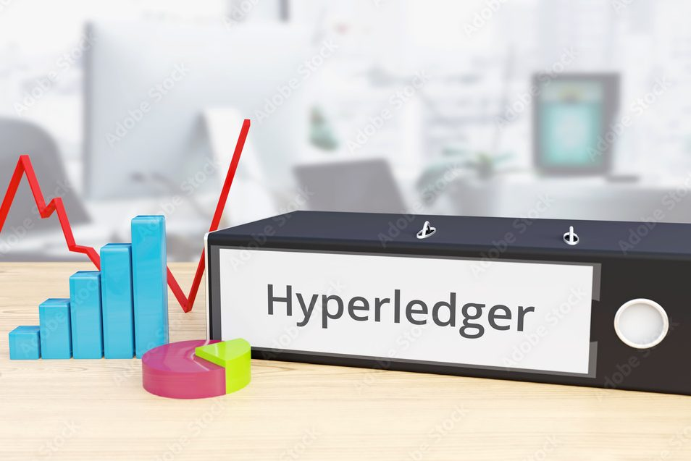
Digital Twin GHG Tracking and Modeling Advantages Through Specific LFDT Components
The difficult task of collecting Scope 3 emissions becomes a straightforward process.
Supply chain emissions data are readily converted into a standardized format, ensuring consistency in data comparisons and calculations using uniform units.
Abide by ISO 14064 data standard series for GHG emission accounting.
Consensus mechanisms that are energy-efficient and designed for enterprise-grade private or permissioned networks. Unlike Proof of Work (PoW) used in blockchains like Bitcoin or Ethereum (prior to Ethereum 2.0), Hyperledger frameworks rely on consensus algorithms with a very small GHG emission footprint.
LFDT architecture provides emission data channels that hold recognized emission factors used by auditors in the data verification process.
Performance: Fabric allows parallel transaction processing, unlike many public blockchains where transactions are serialized. increases throughput significantly.
Fabric provides fine-grained control over data visibility. Organizations can share data only with authorized parties while keeping it confidential from other participants. This makes it ideal for GHG emission tracking.
Allows the creation of private channels, where data and transactions are only visible to authorized members within that channel. This ensures privacy within a consortium of organizations.
Fabric has a “Gateway” component for seamless data collection with the option of collecting data from multiple sources as a “digital thread”. Option for on or off chain storage. Utilizes multi-channel architecture.hin.
Important for GHG emission tracking as it enables secure and decentralized identity management for organizations, devices, and systems involved in reporting and verifying emissions data.hn
Leveraging self-sovereign identity principles, Indy ensures data integrity, privacy, and trust in the entities submitting emissions reports.
Fosters transparency and accountability in tracking greenhouse gas emissions while reducing the reliance on centralized authorities.g
Indy’s blockchain ledger ensures that emissions data and certifications are immutable, preventing fraud or manipulation of records.s in the supply chain.
Important crucial for GHG emission tracking as it enables secure, interoperable, and verifiable communication between entities.t
Facilitates the exchange of verifiable credentials, allowing organizations to prove compliance with emission standards while maintaining data privacy.
Paired with Indy’s decentralized identity framework, Aries ensures trust and transparency in GHG emissions reporting, helping streamline verification processes and enhance accountability across the supply chain.
Automation and Efficiency: Verifiable credentials can automate compliance checks, reducing manual verification efforts and speeding up audits and reporting processes. chain.
Best choice for processing large volumes of GHG emission IoT data.
Its lightweight modular architecture, multi-signature transactions, and focus on digital asset management make it an ideal choice for IoT and GHG emission tracking.
Simpler asset-based data model that’s effective for tracking GHG emission producing assets, identities, and other data types, which fits well with IoT use cases where devices track sensor data or event logs.
Besu provides direct integration to the Ethereum blockchain where GHG offsets are tokenized into digital assets or NFTs and traded on decentralized exchanges.
Besu smart contracts can trigger automated action based on specific conditions or events. An important attribute for the use of a digital twin.
The use of GHG offsets enable supply chains to reach net-zero emissions rapidly prior to more comprehensive changes in the supply chain.
The only fully integrated data solution where investments in green technologies are tokenized into carbon credits and digital tokens, enabling their use in supply chain carbon accounting.
4

Slide 19
Further….. The Value of “Channels” in LFDT Technology for GHG Accounting and Tracking
In LFDT Fabric, channels are private and isolated communication pathways that enable specific participants within a permissioned blockchain network to selectively share data and transactions. They play a fundamental role in ensuring privacy, scalability, and segregation of data in a distributed ledger environment.
Features of channels:
Participants can belong to one or more channels, each with its own ledger, smart contracts (chaincode), and configuration. Transactions executed within a channel are only visible to the participants who have been granted access to that specific channel, ensuring confidential interactions between relevant parties
Isolation of Transactions: Transactions within a channel are only visible to the participating organizations in that channel. Other organizations in the network cannot see or access these transactions, ensuring data privacy.
Private Data Collections: Channel supports private data collections, enabling channel members to share specific data selectively. This proves useful for sensitive information that should not be visible to all participants.
Consensus Mechanism: The organizations within the channel limit consensus, meaning that only channel members validate and agree upon transactions, improving efficiency.
Channel Membership Service Providers (MSPs): MSPs actively manage the identity and access control for participants within a channel, ensuring that only authorized entities can interact within the channel.
Anchor Peers: Each organization participating in a channel designates an anchor peer. These peers maintain the current state of the ledger and serve as the communication endpoint for the organization.
Channel Events: Channels facilitate the broadcasting of events to interested parties, allowing real-time notifications of important updates and transactions.
Source: https://astconsulting.in/blog/2023/07/29/understanding-channels-hyperledger/

Slide 20
The Competitive Advantage of LFDT Platforms Over Other Blockchain Solutions for a Supply Chain Digital Twin (1)
Detailed Advantages
Customizability and Flexibility
LFDT platforms, such as Fabric, Besu, and Iroha offer unparalleled modularity and flexibility compared to other
blockchain solutions. This allows enterprises to customize the network architecture, consensus protocols, and access
permissions for their supply chain digital twin as global GHG emission regulations evolve.
Scalability for Enterprise Applications LFDT platforms are designed to handle the scale and complexity of modern supply chains. By enabling features such as sharding and parallel processing, LFDT platforms can accommodate high transaction volumes and diverse data flows, using data channels, critical for creating an accurate and real-time digital twin of a global supply chain network.
Enhanced Data Privacy and Security Unlike public blockchain solutions, LFDT platforms provide robust privacy features through permissioned networks and private data collections. Supply chain digital twins often handle sensitive information, such as trade secrets, vendor agreements, GHG emissions, or shipment details. LFDT ensures that only authorized participants can access or modify this data, reducing the risk of leaks or cyberattacks.
Support for IoT and Sensor Data Integration Supply chain digital twins rely on real-time data from IoT devices, sensors, and GPS trackers. LFDT platforms, such as FABRIC channel architecture, excel in ingesting, processing, and securely storing large data streams.
The contents of this slide were collected from OpenAI responses to questions centered on the advantages of digital twins.

Slide 21
The Competitive Advantage of LFDT Platforms Over Other Blockchain Solutions for a Supply Chain Digital Twin (2)
Detailed Advantages Continued………………………..
Seamless Integration with Existing Systems LFDT platforms emphasize interoperability and integration, allowing seamless communication between legacy systems (e.g., ERP and WMS) and IoT devices. This is essential for building a cohesive digital twin that incorporates physical, digital, and logistical elements of the supply chain.
No Cryptocurrency Dependency LFDT platforms do not rely on native cryptocurrencies to operate, avoiding the challenges of volatility, regulatory scrutiny, and unnecessary overhead costs. For supply chains, this ensures that blockchain technology can focus solely on improving transparency, traceability, and efficiency without distractions from token-based incentives.
5. Enterprise-Grade Features
Advantage: LFDT platforms and tools support features like:
High throughput and scalability (e.g., Fabric's channel system).
Advanced privacy controls (e.g., private data collections).
Rich querying capabilities (e.g., using CouchDB).
Why It Matters: These features make LFDT platforms ideal for enterprise applications like supply chain management and
the deployment of a digital twin for simulation of GHG emissions.
The contents of this slide were collected from openAI responses to questions centered on the advantages of digital twins.

Slide 22
A Use Case
LFDT Reference Architecture
for a
Simulation Digital Twin
to
Model Supply Chain
GHG Emissions
Solution and Business View

Slide 23







LFDT Supply Chain Decarbonization Products
LFDT Platforms are a Reference Architecture for Supply Chain Decarbonization
Build the foundation for a decarbonization pathway with the use of LFDT platforms and systems.
As one example, demonstrate how the functionality within a Digital Twin enables supply chain actionable Insights:
LFDT platforms/tools: Besu, Fabric, Iroha, Indy, Aries
GHG Inventories - Calcs
Emission Tracking
Model Emissions
Predict Pathways
Strategy
Flexible Data
Collection
Real Time Tracking
Of
Supply Chain Emissions
By
Segment
Supply Chain
Engagement
Automate GHG Inventories
Flexible Data Collection
Custom Emission Factors
Supply Chain Engagement
Scenario and Sensitivity
AnalysisI
Robust Baseline Projections
Mitigation Option Evaluation
Automate GHG Inventories
Flexible Data Collection
Custom Emission Factors
Supply Chain Engagement
Transparent and auditable calculations
Identify
Patterns and Emission
Hotspots
Offsets / carbon credit forecasting
Compare emissions
sources and resource consumption
Emissions factor database including EPA, IPCC, GHG Protocol
Low carbon
Scenario
Building
Mitigation Option
Evaluation
Transition Risk Management
Aggregate, sort, and
filter emissions data
Automate GHG Inventories
Flexible Data Collection
Custom Emission Factors
Supply Chain Engagement
LFDT – Linux Foundation Decentralized Trust

Slide 24
LFDT Platforms are Best-in-Class to Serve as a Reference Architecture for Digital Twin Tracking
4
Deploying a digital twin for a supply chain involves developing a virtual supply chain to accurately reflect the physical assets responsible for GHG emissions. This digital representation enables the following emission measurement and planning processes.
Provides a platform to develop and test supply chain GHG emissions scenarios and develop specific plans based on such scenarios to mitigate.
Data results from scenarios represent emission baselines.
Simulation
The digital twin is an interactive, AI and IoT enabled, real time tracking of GHG emissions in every single step of the supply chain.
Compares against the emissions baseline.
Real Time Monitor
Granular Analysis
Provides granular insight into the highest emitter portion of a supply chain with a guide as to corrective action. Compares actual GHG emissions against a net-zero baseline to track emission goals.
Optimization
Compares actual GHG emissions against a net-zero baseline to track emission goals.
Credit Markets
Integration to carbon credit markets enabling the purchase and sale of credits generated by supply chain activities in real time!
AI model integration
Can provide additional guidance on approaches for emission reduction.

Slide 25
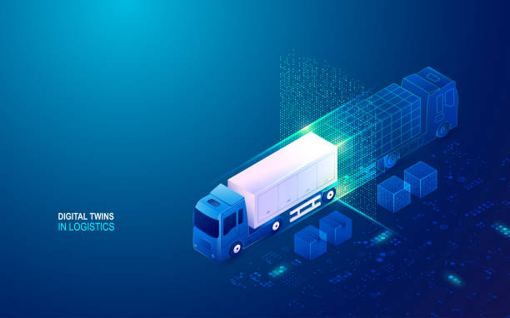

Operation of a Blockchain Digital Twin for Supply Chain GHG Emission Tracking (1 of 3)
Real-Time Monitoring: Monitor in real-time supply chain GHG emissions
The digital twin is an interactive, AI and IoT enabled, real time tracking of GHG emissions in every single step of the supply chain.
Compares actual GHG emissions for the supply chain against a baseline to provide progress toward an organization’s emission goals.
Compares actual GHG emissions against a net-zero baseline to provide progress toward an organization’s emission goals.
The digital twin receives real-time supply chain emissions data, enabling immediate corrective action, if necessary, with assistance from GHG emissions accounting experts and Artificial Intelligence.
Provides a granular insight into the highest emitter portion of a supply chain with a guide as to corrective action.
LFDT Platform Digital Twin Functions:
Provides a platform to simulate and test supply chain GHG emission scenarios and develop specific plans
based on such scenarios to mitigate Scope 1,2,3 emissions.
Static model creation – create a GHG emissions baseline model of the existing supply chain.
Dynamic model creation – add dynamic elements such as real-time data feeds, emission
sources, and constraints based upon interactive emission measures on the active supply
chain.
Contains a network structure, client applications, and chaincode functionality,
providing data input flexibility(IoT, manual entries).
Build an emissions baseline from published emission factors.
Digital Twin Peer LFDT Blockchain Node
data -> transaction request
data -> transaction request

Slide 26
Operation of a Blockchain Digital Twin for Supply Chain GHG Emission Tracking (2 of 3)
The Digital Twin Enables Developing Supply Chain Emission Scenarios
In the digital twin, develop a GHG emissions baseline of your supply chain to provide a comparison of the expected vs actual emissions as the supply chain is in operation.
Create a “Best Case” GHG emission supply chain: Compare the supply chain’s current GHG emissions against a net-zero emissions baseline(no net emissions).
Create a net-zero GHG emission representation of the supply chain. This is an exercise in zeroing out the net emissions of the supply chain by examining the GHG emissions of each asset and determining how to eliminate or offset these emissions.
Associate the baseline climate change GHG emission amounts with each “asset” on the Fabric blockchain. Baseline emissions are the existing expected level as measured or sourced from standard table emissions.
What-If Analysis: Simulate different scenarios (e.g., component problems creating higher emissions, supply disruptions) to understand potential impacts and outcomes.
Optimization: Use the digital twin to identify optimal inventory levels, transportation routes, and production schedules.
Real-time tracking of GHG emissions from individual segments of the supply chain.
Enables granular analysis of emissions to investigate the major players accountable for deviation from planned emissions.
Can be used to determine an alternative supplier
where their supply chain emissions are less than
the current supplier.
Provides detail into the renewable energy credit
market(REC) for purchases to arrive at a net-zero level
of GHG emissions. Can also be used to determine if
if the supply chain has generated RECs.

Slide 27
Operation of a Blockchain Digital Twin for Supply Chain GHG Emission Tracking (3 of 3)
Interactive Dashboards and Reports
Real-Time Dashboards: Create dashboards that provide real-time visibility into key performance indicators (KPIs) like supply chain component GHG emission rates, carbon offset bank total, and in-flight total emissions.
Performance Dashboards: Implement dashboards to track progress towards net-zero goals and identify supply chain segments
responsible for the majority of emissions.
Create dashboards that provide real-time visibility into key performance indicators (KPIs) like supply chain component GHG emission rates, carbon offset bank total, and in-flight total emissions.. Solved by the Open Global Climate Accounting System????
Route Planning: Use advanced logistics software to plan the most efficient routes, reducing fuel consumption and emissions
Data Analytics
Real-Time Analytics: Use streaming analytics tools to process and analyze emission data as it arrives.
Machine Learning: Implement machine learning models to predict trends, detect anomalies, and optimize processes(in need of a detailed example).
Visualization Tools
3D Visualization: Use 3D modeling tools to create a visual representation of the supply chain.
GIS Mapping: Integrate Geographic Information Systems for spatial analysis and visualization of supply chain routes and locations.

Slide 28
LFDT Blockchain
Pictorial Demonstration
Digital Twin
to
Track and Model
GHG Emissions
Demonstrate Value

Slide 29
Solution Architecture for the Entire Supply Chain Digital Twin
A global solution architecture for digital twins covering the entire supply chain. While not all firms within the supply chain are required to implement digital twins, real-time or batch entry of GHG emissions data is mandatory across the entire supply chain to track and measure overall carbon emissions
Need New CHANNEL focus (orderers, peers, clients
Blockchain Digital Twin Network Interactions
Each member in the supply chain provides emission data to their blockchain node or to a partner’s blockchain instance.
GHG emission data are entered as transactions in the blockchain. As each transaction is entered, it is broadcast to all other nodes in this supply chain digital twin.
A member without a node can provide APIs for integration to their internal systems.
Company n+7
Company n
There is no single blockchain. Each node stores its own copy. All nodes do their best to stay in sync.
IoT stream
Digital Twin Node
Digital Twin Node
IoT stream
The Blockchain
The Blockchain
Company n+2
No Blockchain node
Send emission data to Company n+1
Company n+6
Company n+1
IoT stream
Digital Twin Node
Nodes share new blocks and transactions with each other.
Digital Twin Node
real-time or batch data
The Blockchain
The Blockchain
FROM OTHER CARBON ACCOUNTING SYSTEM
Feed from other carbon accounting platform
Receive audited emissions (example)
TO OTHER CARBON ACCOUNTING SYSTEM
Feed TO other carbon accounting platform
Send data for auditing or reporting
Company n+4
Company n+3
Digital Twin Node
Digital Twin Node
Creator Transaction Field - The identity of the entity (user or client application) that submitted the transaction.
It is used to authenticate and authorize the transaction using digital certificates tied to the submitter's identity.
real-time or batch data
The Blockchain
The Blockchain
IoT stream
From any blockchain node in the network, the GHG emissions generated in the entire supply chain can be observed in real-time.

Slide 30


Example: Historical and Real Time Tracking of Supply Chain Emissions
A global exporter of African grown coffee has a supply chain covering a large geographic area. The suppliers of coffee and coffee bags transmit their GHG emissions associated with their operations to this exporter to include in the total emissions for this supply chain.
Listed below are the supply chain activities where GHG emissions are higher than planned.
Numbers below are an average of the 2 previous runs plus the In-Process run minus the baseline.
3) View the current state of emissions from the supply chain in motion.
The supply chain is currently in operation. As shown below, the loading of coffee bags onto the ocean steamship vessel is
underway. GHG emissions for this activity are received every minute through an IoT interface to enable observation in real
time. FORKLIFT activity is underway.
Collect Current Emission Baseline for our supply chain segment.
In the leftmost(yellow) box are the expected GHG emissions derived from emission modeling. The granularity of the different
activities in this supply chain are displayed along with their expected individual emission contributing to the total for the
supply chain. These are considered the baseline-expected values.
Note: The details on how these emission values were determined is not in scope.
2) Pull last 2 previous supply chain runs
Has the amount of emissions from this supply chain performed as expected or has there been an increase over the
baseline? An emission increase over a period of time results in the need to perform modeling and/or discuss with
supply chain actors.
[ LFDT Systems Used: Fabric, Besu, Indy, Explorer, Cacti ]
DT Baseline (metric tons of CO2e)
SC run 10.03.24 (mtons of CO2e)
SC run 10.15.24 (mtons of CO2e)
In Process (mtons of CO2e)
Issues (mtons of CO2e)
.34
Manuf. of coffee bags
.34
Manuf. of coffee bags
.55
Manuf. of coffee bags
.45
Manuf. of coffee bags
.50
Manuf. of coffee bags
+.16
Coffee supplier
293.
Coffee supplier
304
Coffee supplier
304
Coffee supplier
309
Coffee supplier
+29
Trucking to Warehouse
- Freight Co. #2
- unloading
Trucking to Warehouse
- Freight Co. #2
- unloading
Trucking to Warehouse
- Freight Co. #2
- unloading
Trucking to Warehouse
- Freight Co. #2
- unloading
Trucking to Warehouse
- Freight Co. #2
- unloading
2.9
3.4
3.3
3.6
+.53
.94
1.1
.91
.99
+.06
Warehouse ops (year)
Warehouse ops (year)
Warehouse ops (year)
Warehouse ops (year)
Warehouse ops
- Heating / cooling
45.4
- Heating / cooling
51.1
- Heating / cooling
49.9
- Heating / cooling
61.1
- Heating / cooling
+8.6
Coffee bag loading on ship
Coffee bag loading on ship
Coffee bag loading on ship
Coffee bag loading on ship
Coffee bag loading on ship
- forklift ops
2.4
- forklift ops
2.4
- forklift ops
2.6
- forklift ops
1.2
- forklift ops
- cranes for loading
4.4
- cranes for loading
4.6
- cranes for loading
4.4
- cranes for loading
----
- cranes for loading
----
Ship to N.Y. harbor
1.9
Ship to N.Y. harbor
2.0
Ship to N.Y. harbor
1.7
Ship to N.Y. harbor
----
Ship to N.Y. harbor
----
Purchase GHG credits
0.0
Purchase GHG credits
0.0
Purchase GHG credits
0.0
Purchase GHG credits
---
Purchase GHG credits
---
Total
351.3
Total
369.1
Total
367.3
Current Total
376.4

Slide 31
Model: Use Digital Twin for an Approach to Reduce GHG Emissions to Target ( 1 of 2 )
Using Hyperledger software as the digital twin platform, we can model GHG emissions within the supply chain, enabling progress towards targeted emission reduction levels.
Example: A fictional supply chain for exporting coffee from Ethiopia to a harbor on the U.S. East Coast involves multiple segments, each representing a chain of custody transfer. Each segment contributes to the total GHG emissions generated per shipment through this supply chain.
LFDT Products: Fabric, Indy, Explorer
Reduction Target: > 50% GHG emission reduction
DT Baseline (metric tons of CO2e)
Model Run 1 (tons of CO2e)
Model Run 2 (tons of CO2e)
Model Results (tons of CO2e)
.13
Changed Freight company to reduce emissions and more efficient operations.
.13
Manuf. of coffee bags
.13
Manuf. of coffee bags
Manuf. of coffee bags
Manuf. of coffee bags
.34
77.9
293
Coffee supplier
77.9
77.9
Coffee supplier
Coffee supplier
Coffee supplier
Trucking to Warehouse
- Freight Co. #2
- unloading
Trucking to Warehouse
- Freight Co. #new2
- unloading
74% GHG emission reduction
Trucking to Warehouse
- Freight Co. #2
- unloading
2.9
.94
Trucking to Warehouse
- Freight Co. #2
- unloading
2.9
2.2
.66
2.2
.66
.94
Warehouse ops
Warehouse ops
45.4
Warehouse ops
45.4
Warehouse ops
.09
- Heating / cooling
45.4
- Heating / cooling
- Heating / cooling
Switch to solar panels and upgrade warehouse HVAC equipment to reduce GHG emissions.
- Heating / cooling
Coffee bag loading on ship
Coffee bag loading on ship
Coffee bag loading on ship
Coffee bag loading on ship
- forklift ops
2.4
Activity Approach
- forklift ops
2.4
- forklift ops
2.4
- forklift ops
2.4
- cranes for loading
4.4
- cranes for loading
4.4
- cranes for loading
4.4
- cranes for loading
4.4
Ship to N.Y. harbor
1.9
Ship to N.Y. harbor
1.9
Ship to N.Y. harbor
1.9
Ship to N.Y. harbor
1.9
Purchase GHG credits
0.0
Purchase GHG credits
0.0
Purchase GHG credits
0.0
Purchase GHG credits
0.0
Total
351.3
Total
136.0
Total
135.0
Total
89.7
GHG Emission Reductions
Switch in coffee bags from plastic to cloth material.
Purchase of coffee from farms that grow organically reduces GHG emissions significantly from 293 to 77.9 mtons on this shipment.
Reduction from 3.84 to 2.86
Transferred trucking operations to a new supplier with new trucks and more efficient unloading operations.
Reduction from 45.4 to .09 tons
Switch over to solar for electricity.
Heating and humidity control equipment is older and less efficient than newer versions. Decision made to spend the capital to upgrade all equipment related to keeping the warehouse at the required conditions for coffee storage reducing emissions
Activity Approach: Review emissions from each step and determine where improvements are practical resulting in a reduction in GHG emissions. Negotiations with suppliers and operators are viable options.

Slide 32
Model: Digital Twin to Model a Net Zero Approach to Reduce GHG Emissions (2 of 2)
To reach a goal of Net Zero GHG emissions in this supply chain example, GHG emission credits are needed to offset emission intensive actions.
Using the African coffee supply chain once again as a demonstration( from the previous slide ), and utilizing the emission reductions from actions already taken through supplier negotiation, GHG credits are the remaining option.
Note: Actions already taken may have generated credits themselves reducing the number of credits acquired out in the open market.
LFDT Products: Fabric, Indy, Explorer, Besu
DT Model Baseline (mtons of CO2e)
Model Results (mtons of CO2e)
Net Zero (tons of CO2e)
Manuf. of coffee bags
.34
Manuf. of coffee bags
Manuf. of coffee bags
.13
293
.13
Coffee supplier
77.9
Example: Renewable energy(REC) credits were generated due to operational improvements in this supply chain. Each run of the supply chain generates credits which are then consumed internally during each operation.
However, the amount of credits generated internally are less than needed during ecah supply chain run to meet net-zero.
To reach net-zero, the supply chain owner and partners are required to purchase additional RECs out in the open market.
77.9
Purchase credits in the open market or register and utilize credits from capital improvements.
Coffee supplier
Trucking to Warehouse
- Freight Co. #2
- unloading
Coffee supplier
2.9
Trucking to Warehouse
- Freight Co. #2
- unloading
Trucking to Warehouse
- Freight Co. #2
- unloading
.94
Activities
2.2
.66
2.2
.66
Warehouse ops
45.4
Warehouse ops
Warehouse ops
- Heating / cooling
- Heating / cooling
.09
- Heating / cooling
.09
Coffee bag loading on ship
Coffee bag loading on ship
Coffee bag loading on ship
- forklift ops
2.4
- forklift ops
2.4
- cranes for loading
4.4
- forklift ops
2.4
- cranes for loading
4.4
Ship to N.Y. harbor
1.9
- cranes for loading
4.4
Ship to N.Y. harbor
1.9
Ship to N.Y. harbor
1.9
Utilize GHG credits
0.0
Utilize GHG credits
0.0
Utilize RECs
89.7
Total
351.3
Total
Total
0.0
89.7
The most recent emissions baseline for this supply chain has been modeled resulting in a 74% reduction as shown in the 2nd rectangle entitled “Model Results”. The amount of GHG credits needed is based upon thar completed and verified actions. How GHG credits are gained and applied is now shown.
Digital Twin stores these values for comparison purposes.
GHG emission credits can be gained used from 2 sources.
1) Internally generated by more efficient
operations from capital improvements or demands on suppliers.
2) Purchased in the open market from suppliers where emission credits have been audited.
89.7 mtons CO2e GHG emission credits applied to reach net zero.

Slide 33
Create a Granular View of GHG Emissions Within Supply Chain Assets
Accurate Measurement: Granular data provides precise insights into where emissions are being generated, enabling more effective identification of high-emission sources and hotspots.
Targeted Mitigation: Organizations can develop focused strategies to reduce emissions in specific areas, processes, or facilities, maximizing the impact of reduction efforts.
Improved Accountability: Detailed tracking enhances transparency, holding individual entities or processes accountable for their emissions.
Enhanced Reporting: Granular data supports compliance with regulatory standards and enables detailed reporting for stakeholders and customers.
Better Decision-Making: Access to specific data points enables informed decisions about resource allocation, operational changes, or investments in cleaner technologies.
Supply Chain Insights: For organizations with complex supply chains, granular data highlights inefficiencies and emissions across each link, enabling end-to-end optimization.
Supply Facilitates Innovation: By understanding emissions at a micro level, companies can innovate with targeted solutions, such as improving energy efficiency
Digital Twin GHG Emissions Tracking View
1
DT Model Baseline (mtons of CO2e)
Manuf. of coffee bags
.34
Granular views help establish detailed baselines for emissions, making it easier to measure progress and adjust strategies dynamically.
Coffee supplier
293
2
Trucking to Warehouse
- Freight Co. #2
- unloading
2.9
.94
Warehouse ops
- Heating / cooling
45.4
3
Coffee bag loading on ship
- forklift ops
2.4
- cranes for loading
4.4
Ship to N.Y. harbor
1.9
Warehouse ops (mtons CO2)
Utilize GHG credits
0.0
4
Heating
- air
- water
- drying
- humidity control
11.2
Total
351.3
1.5
5.4
0.5
5
Cooling
- air
- humidity
- water
24.2
2.3
0.3
6
The entire GHG emission footprint associated with the storage warehouse is only an example of a facility lacking any renewable energy source. If however, capital investment for renewable sources of energy such as solar panels, live-market purchases of renewable electricity and any other actions can produce “carbon-offset” / credits to offset other emissions emanating from this supply chain.
7

Slide 34
LFDT Blockchain
Solution
Architecture
for a Digital Twin
to
Track and Model
GHG Emissions
(Technical with Processes)

Slide 35
Digital Twin Technical Architecture Design Decisions (1 of 2)
With no reference architecture in place, as it relates to the management of greenhouse gas emissions, a first step in the design of the net-zero digital twin is development of a reference architecture to guide all solutions.
Component Options Architecture Selection
Blockchain
ethereum
Hyperledger Fabric
LFDT platforms superior processing speed on large volumes of GHG emission IoT data through the use of Fabric channels and Iroha. Chaincode(smart contract) provides logic to define the digital twin through objects(struct).
Infrastructure
on premises
cloud hosting (AWS, Azure)
Hybrid hosting model
Off prem cloud hosting has low cost, scalability, and reliability advantages over on-prem hosting. Dependent upon the security demand on this solution(data and access) an on-prem infrastructure would be required as a second choice.
security
private/public key pair
hash algorithm
wallet
…..there are multiple areas to highlight from user access to data integration. How are data received from corporate end points into a gateway for the blockchain into a smart contract……..
application pattern
microservices
event driven
serverless
smart contract / chaincode
…..selection is based on requirements mostly – not the non-functional requirements. For this business case, multiple integration patterns most likely due to varied need on handling data and user alerts……..
data integration
gRPC
SDK
REST API
hybrid
MQTT is the selected protocol due to its standardization and ubiquitous ecosystem. Standardize on the use of SDKs when establishing connections to the Fabric Gateway, which internally uses gRPC. Besu provides direct integration to the Ethereum blockchain.

Slide 36
Digital Twin Technical Architecture Design Decisions (2 of 2)
With no reference architecture in place, as it relates to the management of greenhouse gas emissions, a first step in the design of the net-zero digital twin is development of a reference architecture to guide all solutions.
Component Options Architecture Selection
scalability strategy
horizontal
auto-scaling
caching
….load balancing….serverless computing(FaaS)…use of microservices…containerization and orchestration….provide architecture justification for use of the selected tool set.
World State
L2 needed
IPFS
NoSQL
Utilize a world state database to provide a fast, query view of the latest values of all assets and records. Utilize a relational database alongside the blockchain to collect large volumes of real-time data (NoSQL - CouchDB). Supply Chain configuration detail is stored on a blockchain.
storage
AI integration
MCP standard
db access direct
augment LLM data set
…. (MCP) is an open standard designed to streamline AI integration by providing a universal way for AI models to connect with external data sources, tools, and services. Applies to carbon credit market and logistics(supply chain)realtime data…
cryptography
hash algorithm method
digital certificates(access)
signed transactions
off-chain storage hash method
…..SHAXXX…. Every actor in the network (applications, peers, orderers) has a digital identity represented by an X.509 certificate issued by a trusted Certificate Authority…..hash all data when stored off-chain….external data private/pub key..
lightweight
virtualization
containerization
orchestration
virtual machines
….. key technology for modern cloud-native applications, enabling portability, scalability, and rapid deployment.…..Docker and Kubernetes most popular and stable…. Containers are well-suited for microservices architectures, allowing for independent deployment and scaling of individual services.

Slide 37
Solution Architecture
Table of Contents
Table of Contents
1
Blockchain
2
Infrastructure
3
Data Integration
4
Security
5
Data Storage
6
Application
7
AI Links to LLMs
8
Nothing Here…..
9
Also Empty………

Slide 38
Architecture Design Decisions – Use Blockchain Technology
Blockchain and relational databases (SQL and no-SQL) overlap in some ways (both store and query data), but they’re designed for different problems. Here are the advantages of blockchain technology over SQL databases for the tracking, modeling, and reporting greenhouse gas emissions from supply chains :
1
Blockchain data is immutable. Key attribute when data is subject to auditing such as GHG emissions. Immutability & Tamper Resistance - Data, once written
and confirmed, cannot be modified or deleted without consensus. Needed for emissions auditing.
2
A key factor when measuring GHG emissions is Transparency & Auditability of the data. All transactions are timestamped, traceable, and visible (either
publicly or within a permissioned network).
3
Supply chain configurations at a particular point in time are saved in the blockchain( as a transaction ) , linked with GHG emissions over the configuration
time period resulting in an immutable view of supply chain GHG emissions over time.
4
Security by Design : Blockchains use cryptographic techniques (hashing, digital signatures, consensus) to secure transactions.
5
Trust Across Organizations : Supply chains are comprised of a significant number of partners. Blockchain: Enables multiple independent parties (suppliers,
regulators, banks) to share and verify data without needing to trust a central authority.
6
Smart Contracts (chaincode) : Blockchains embed rules that automatically execute when conditions are met (e.g., release payment once shipment
arrives).

Slide 39
Digital Twin Instantiation and Data Architecture (1 of 2)
Source: Data modelling team. The digital twin is represented as a set of structures(struct) within a smart contract. The diagram below details the structures and relationships. Supply chains are represented as “segments” having emission sources.
The Supply Chain digital twin is represented by a smart contract (pseudo code similar to Solidity)
\\ data model implemented in structures
contract netzero {
struct digitaltwin {
string twinname;
string twinowner;
uint256 timestamp;
supplychainseg[] segments;
uint256 twinID;
bool isModel;
bool isActive }
// where GHG emissions originate
struct Segment {
uint256 twinID;
uint256 segnum;
string segmentName;
uint256 ghgBaseline;
segEmissionSource[] sources;
string emissionUnits;
uint256 ghgFromSupplier;
uint256 scope;
uint256 length;
uint256 lengthUnits }
// what equip / device caused GHG emissions
struct segEmissionSource {
uint256 segnum;
string emissionSource_describe, // (truck, plane, warehouse heat, cold, water)
IoTDevice [] devices, // if IoT device emission source
uint256 ghgBaselineAmount;
string emissionUnits; }
// Continued on next slide…….
a “struct” data structure in the smart contract defines the digital twin.
a supply chain consists of a single or multiple segments, with the
segments defined in a related “struct” data structure.
each supply chain segment definition is contained in this “struct”. Forms
a one to many relationship of segments to a digital twin.
a supply chain segment has multiple ghg emission sources. Must have at
least 1 emission source for each supply chain segment.
“struct” definition for segment ghg emission sources and its baseline
“devices” is the reference object for gathering emission data

Slide 40
Digital Twin Instantiation and Data Architecture (2 of 2)
Source: Data modelling team. Each IoT device is defined as a data object(struct) in a smart contract associated with emission data represented as a structure(struct) within a smart contract. The diagram below details the structures.
IoT device and Emissions Data representation (pseudo code)
…..netzero smart contract continued
struct IoTDevice {
string owner ;
string UUID;
string device_type;
EmissionData[] emmissionsbyDevice;
string capability;
Boolean isActive;
string data_stream_link }
struct EmissionData {
string UUID; // device this emission came from
uint256 timestamp; // When it was recorded
uint256 emissionfactor // 0.0 – 1.0
uint256 emissionValue; // e.g., 420
string units; // e.g., "gCO2/km“ }
struct exceed_actions {
number baseline;
string msg;
string action_options;
//* perform smart contract defined actions
if (exceed _high) – logic here
if (problem) – logic here
}
// end netzero contract
Collect IoT device identifiers
a) create a unique identity using the IoT UUID or the device’s MAC address.
b) This structure is used to register devices such as CO2 sensors, water flow monitors,
and fuel burn trackers.
2) Define smart contracts on the selected blockchain
a) define the logic in a smart contract to be associated with the IoT device(if the
measurement is out of range perform some action triggering activity).
b) code a struct in the smart contract for IoT information.
c) code the smart contract blockchain actions to be performed when exceeding
thresholds.
d) “units” to record emissions per km, timeframe, unit of production
3) Add the device to the blockchain’s smart contract
a) through a blockchain transaction, add the device to the target smart contract entering
its unique identifier linking the data stream to the smart contract.
ctx = IoTDevice_register( data_stream_id, owner, UUID)
b) link the IoT device identifier with metadata such as owner, device type, capabilities
Cryptographically sign transactions for blockchain or off-chain storage
a) Data Transmission: IoT device sends signed temperature data via a gateway, API or
other middleware to the smart contract on a blockchain node.

Slide 41
Example Smart Contract Function for Digital Twin Instantiation (1of 2)
The following functions in pseudo code establish a digital twin representation of a supply chain. The accompanying code also illustrates the hierarchical structure and relationships among the key components within the model.
digitaltwin[] public twins;
uint256 public nextTwinID = 1;
function addDigitalTwin(string memory _twinname, string memory _twinowner) public {
digitaltwin memory newTwin = digitaltwin({
twinname: _twinname,
twinowner: _twinowner,
timestamp: block.timestamp,
segments: new Segment ,
twinID: twins.length,
isModel: False;
isActive: true
});
twins.push(newTwin);
}
function addSegmentToTwin(uint256 twinIndex, string memory segmentName,
uint256 ghgBaseline, string memory emissionUnits,
uint256 ghgFromSupplier, uint256 length, uint256 lengthUnits
) public {
require(twinIndex < twins.length, "Invalid twin index");
Segment memory newSegment = Segment({
segnum: twins[twinIndex].segments.length,
segmentName: segmentName,
ghgBaseline: ghgBaseline,
sources: new segEmissionSource ,
emissionUnits: emissionUnits,
ghgFromSupplier: ghgFromSupplier,
length: length,
lengthUnits: lengthUnits,
modelRun: new em_model
});
twins[twinIndex].segments.push(newSegment);
}
every digital twin can hold a list(array) of Segment objects
create function for the digital twin. Related structures added in other functions.
Example: addDigitalTwin("SolarFarm-001", "CompanyA");
instruction code to instantiate the digital twin
call signature for the function to add a segment(s) to the digital twin.
addSegmentToTwin(0, "Transport A", 120, "kgCO2", 10, 200, 1);
code to assign values and instantiate a segment to a digital twin.
Data hierarchy: Digital Twin (twins[0])
|── Segment 0 (trucking)
| └── Emission Source 1 (truck)
│ └── Emission Source 2 (plane)
| └── Emission Source 3 (warehouse heat)
| ─ Segment 1 (shipping)
│ └── 3 Emission Sources
|── Segment 2 (storage)
│ └── 3 Emission Sources
|── Segment 3 (delivery)
│ └── 3 Emission Sources

Slide 42
Example Smart Contract Function to Register an IoT Device
Example pseudo code function for registering an IoT device on a blockchain. There are additional steps to be performed on the device itself prior to connection to the blockchain. Structures in a smart contract define these actions.
An example function to register the device on the blockchain.
a) create a unique identity using the IoT UUID or the device’s MAC address.
b) system controllers register devices using IoTDevice which includes the
UUID, type, capabilities, and status.
2) The signature for the function to register is the following:
await contract.methods.registerDevice(
“some supplier Corp",
“UUID",
"CO2_Sensor",
"emissions_reporting",
"ipfs://example-data-link" ).send({ from: adminAddress });
- performed as a transaction to call this smart contract called “IoTDevices
- CALLED BY - IoT gateways or devices (via backend code using Web3.js, Web3.py,
Ethers.js, etc.)
What Happens on the Blockchain
a) The device info is stored immutably in the devices mapping
b) The device can be looked up on the blockchain via devices[“UUID”]
Security
a) If the policy is to allow anyone to register a device , remove the onlyAdmin
modifier.
contract IoTDevices { ….cont with smart contract
// Function to register a new device
function registerDevice(
string memory _owner,
string memory _UUID,
string memory _device_type,
string memory _capability,
string memory _data_stream_link
) public onlyAdmin {
// Ensure it hasn’t been registered before
require(bytes(devices[_UUID].UUID).length == 0, "Device already
registered");
devices[_UUID] = IoTDevice_register({
owner: _owner,
UUID: _UUID,
device_type: _device_type,
capability: _capability,
isActive: true,
data_stream_link: _data_stream_link
});

Slide 43
Example Smart Contract Function to Add Emission Source and IoT Reading
Example pseudo code rto an IoT device on a blockchain. There are additional steps to be performed on the device itself prior to connection to the blockchain. Structures in a smart contract define these actions.
function addEmissionSource(
uint256 twinIndex,
uint256 segmentIndex,
string memory sourceName,
uint256 baselineAmount,
string memory emissionUnits
) public {
require(twinIndex < twins.length, "Invalid twin index");
require(segmentIndex < twins[twinIndex].segments.length, "Invalid segment index");
segEmissionSource memory newSource = segEmissionSource({
emissionSource: sourceName,
ghgBaselineAmount: baselineAmount,
emissionUnits: emissionUnits,
emissionreading: new EmissionSourceReading
});
twins[twinIndex].segments[segmentIndex].sources.push(newSource);
// 🔹 Enter a GHG Reading from IoT Device
function addEmissionReading(
uint256 segIndex,
uint256 sourceIndex,
uint256 deviceIndex,
uint256 _ghgAmount,
string memory _units
) public {
require(segIndex < segments.length, "Invalid segment index");
require(sourceIndex < segments[segIndex].sources.length, "Invalid source index");
require(deviceIndex < segments[segIndex].sources[sourceIndex].devices.length, "Invalid device index");
IoTDevice storage dev = segments[segIndex].sources[sourceIndex].devices[deviceIndex];
require(dev.isActive, "Device not active");
dev.emissionsByDevice.push(
EmissionData({
timestamp: block.timestamp,
ghgAmount: _ghgAmount,
units: _units
})
);
}
}
Example calls:
addEmissionSource(0, 1, "truck", 1000, "kgCO2")
addEmissionSource(0, 1, "warehouse heat", 500, "kgCO2")
code for placement of emission source config.
code to instantiate emission source.
Example calls:
addEmissionReadingToSource(0, 1, 1012, 250, "kgCO2")
addEmissionReadingToSource(0, 1, 1444, 300, "kgCO2")
Validation checks
locate the device and fetch the IoTDevice struct in storage (not memory)
appends the new reading to the device’s emissionByDevice[] array
Emission data is logically tied back to the device, emission source, and the
supply chain segment.

Slide 44
Data Storage Architecture Key Design Decisions
Supply Chain configuration detail is stored on a blockchain. This approach provides a history of the supply chain configuration and its
associated emissions data. Key – configuration is a set of “State Variables” that are permanently stored in the blockchain.
Utilize a world state database to provide a fast, queryable view of the latest values of all assets and records, so applications don’t need to
scan the entire transaction history to find current data, greatly improving performance for lookups and updates.
Utilize a relational database alongside the blockchain to collect large volumes of real-time data. The advantages are the following:
Store bulk raw data off-chain to avoid inflating the blockchain ledger and incurring high storage or transaction fees.
Leverage indexing and relationships for fast queries, joins, and analytics across large datasets.
Reduce blockchain writes by only committing summarized or critical proofs (e.g., hash of the data) on-chain while keeping the detailed records in the relational database.
Maintain data integrity by cross-referencing on-chain hashes with the off-chain relational data.
Blockchain smart contracts(chaincode) are to be used for automation of business logic, trust, immutability of rules, and transparency.
All data stored are to be encrypted and stored off-chain, while the blockchain is to hold hashes or proofs for immutability, ensuring tamper
resistance, selective disclosure, regulatory compliance, and secure key management without overloading devices or storage.
Utilize cloud services to leverage third-party infrastructure, platforms, or software hosted and managed by external providers instead of
on-premises systems.
Provide data entry screens for the entry of supply chain configuration detail and emission source data values where the collection of real
time data are not selected as part of the digital twin solution.

Slide 45
Architecture Design Decisions – Utilize Blockchain Technology
Blockchain and relational databases (SQL and no-SQL) overlap in some ways (both store and query data), but they’re designed for different problems. Here are the main advantages of blockchain over SQL databases:
1
Blockchain data is immutable. Key attribute when data is subject to auditing. Immutability & Tamper Resistance - Data, once written and confirmed,
cannot be modified or deleted without consensus. Needed for emissions auditing
2
A key factor when measuring ghg emissions is Transparency & Auditability of the data. All transactions are timestamped,
traceable, and visible (either publicly or within a permissioned network).
3
Supply chain configurations at a particular point in time are saved in the blockchain( as a transaction ) , linked with GHG emissions over the configuration
time period resulting in an immutable view of supply chain GHG over time.
4
Security by Design : Blockchains use cryptographic techniques (hashing, digital signatures, consensus) to secure
transactions.
5
Trust Across Organizations : Supply chains are comprised of a significant number of partners. Blockchain: Enables
multiple independent parties (suppliers, regulators, banks) to share and verify data without needing to trust a central
authority.
6
Smart Contracts (chaincode) : Blockchains embed rules that automatically execute when conditions are met (e.g.,
release payment once shipment arrives).

Slide 46


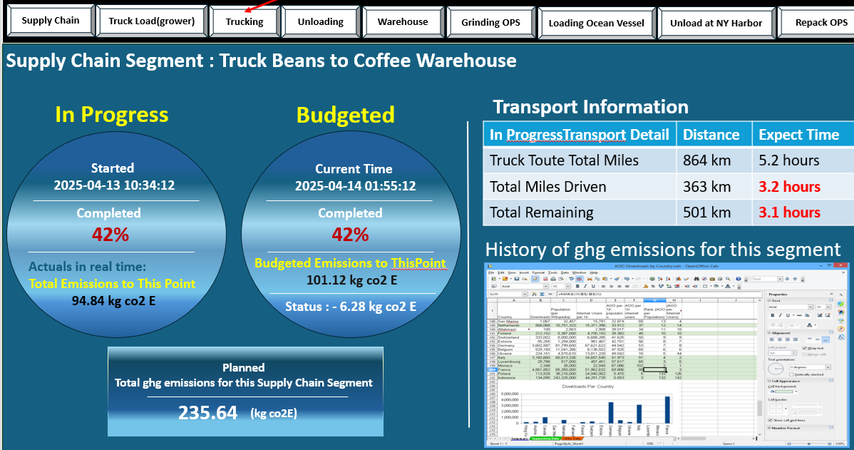
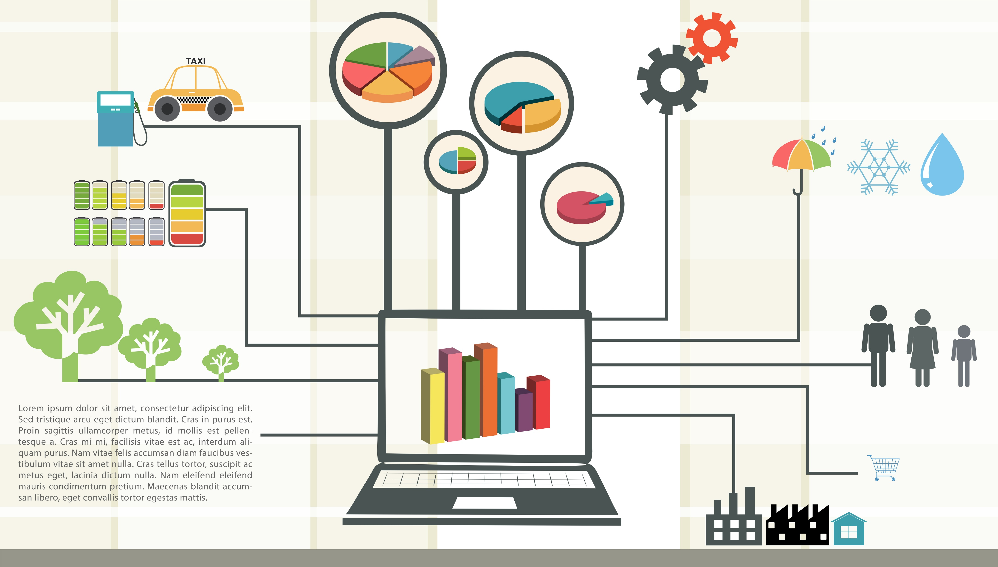
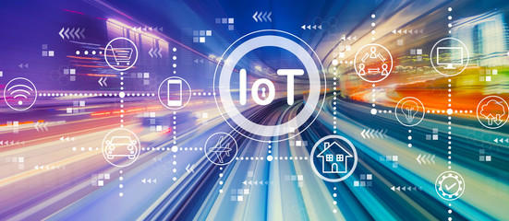
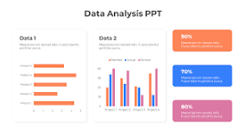

Data Storage Architecture
Fabric Blockchain
World-state
Supply Chain configuration detail is stored on the blockchain. This approach provides a history of the supply chain configuration and its associated emissions data.
A smart contract accepts the entered supply chain configuration, checks for errors, and upon approval is submitted as a blockchain transaction.
A smart contract collects supply chain configuration detail to start a “run”, assigns a run “id”, and associates emission data.
Smart contract collects emission values and through the “device_id” field in the IoT device payload , forms a linkage to the supply chain “segment” at the granular level set.
Smart contract “Updates” the world-state by totaling emission readings received.
The data stream is a pointer to the IoT devices’ live data feed which is an external data source containing the raw sensor data.
Use a relational database alongside blockchain for off-chain querying, analytics, or integration.
Actual raw IoT sensor values are fetched off-chain by an oracle or a backend service when doing verification or analytics. It keeps the world state small and efficient.
Relational DB for Off-chain
State + Analytics
sql database
Smart Contract
raw IoT readings
Smart Contract
{
“device_id": "DEVICE_123456",
"owner": "Factory A",
"UUID": "123456",
"device_type": "CO2 Sensor",
"capability": "CO2_ppm",
"isActive": true,
"data_stream_link": "https://iot.example.com/devices/123456",
"lastEmissionReading": {
"timestamp": 1723561200,
"value": 415.3,
"units": "ppm"
}
}
Supply Chain configuration
Netzero Digital Twin
Segments
segEmissionSource
IoTDevice
EmissionData
Payload
https://iot.example.com/devices/123456
real time tracking
Configure Supply Chain Data Entry Screens
IoT devices
Data entry screen
Business analytics on emissions

Slide 47
Data Integration Architecture Key Design Decisions
Supply Chain IOT -> Edge Device
MQTT is the selected protocol as it has high efficiency, natively supports pub/sub for asynchronous data transfer. In addition, security is
configured with TLS support, and it can have up to QoS0-2 (exactly once data transfer guarantee).
Edge Device -> API Gateway -> Microservices Application
HTTPS REST is to be utilized due to its standardization and ubiquitous ecosystem. Has been associated with ease of implementation.
Microservices -> Fabric
Architecture group has standardized on the use of SDKs when establishing connect to the Fabric Gateway, which internally uses gRPC.
Integration to Artificial Intelligence chatBOTs and LLMs
Data flow connections are to utilize the open standard “Model Context Protocol” referred to as (MCP). This standard is designed to
connect large data models with external tools and data sources. It is a “standardized adapter” allowing AI assistants , or LLM clients, to
discover and interact with a diverse range of external services and data.
The integration process can be described as follows:
microservice calls an MCP endpoint
MCP manages request selecting the model (LLM)
performs the processing of data
returns a standardized(agreed upon) formatted output
MCP will be positioned in the integration architecture as a microservice responsible for AI logic.
Hyperledger Besu to Ethereum Public Blockchain
Besu provides direct integration to the Ethereum blockchain where GHG offsets are tokenized into digital assets or NFTs and traded on
decentralized exchanges.

Slide 48
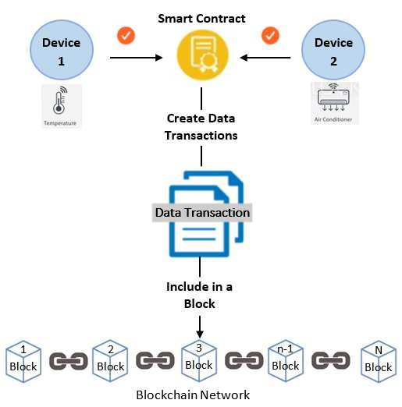
Why Use Blockchain Technology to Register IoT Devices?
Registering IoT devices on the blockchain is a common and recommended pattern when building secure and auditable IoT systems—especially for digital twins, emissions tracking, or supply chain applications. It helps establish device identity, ownership, and trust in the data coming from those devices.
Immutable Device Identity
Prevents spoofing and impersonation.
Each device has a unique ID tied to its public key or metadata.
Ownership and Provenance
Links a device to an organization, twin, or physical asset.
Useful in multi-party environments (e.g., logistics chains).
Auditability
Tracks firmware updates, access logs, and data submissions.
Traceability
1. Track device lifecycle events: registration, activation, deactivation, updates.
2. Useful for GHG audits or supply chain certifications.
Integration with Smart Contracts
1. Smart contracts can reference the device registry to validate data submissions.
2. Enables automated logic based on the sender’s device identity.
Access Control
Use smart contracts to restrict which devices can write data.
Devices can sign messages to prove authenticity.

Slide 49

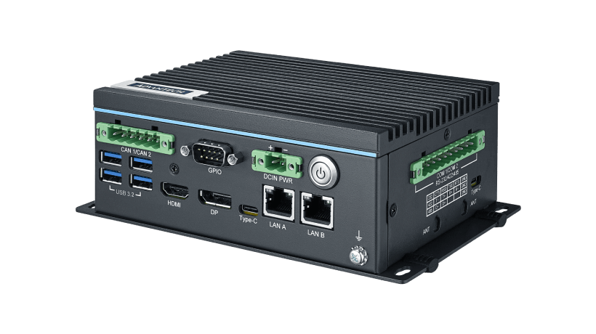

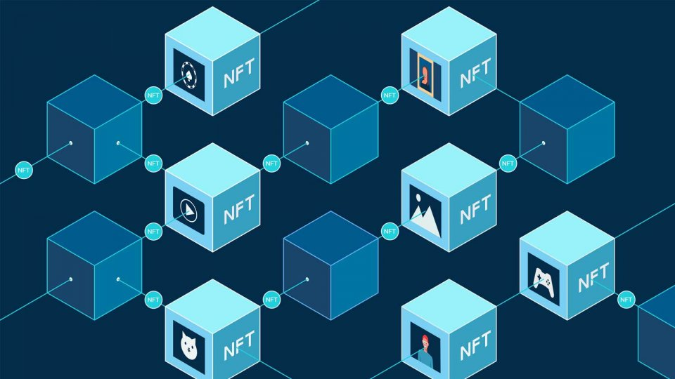
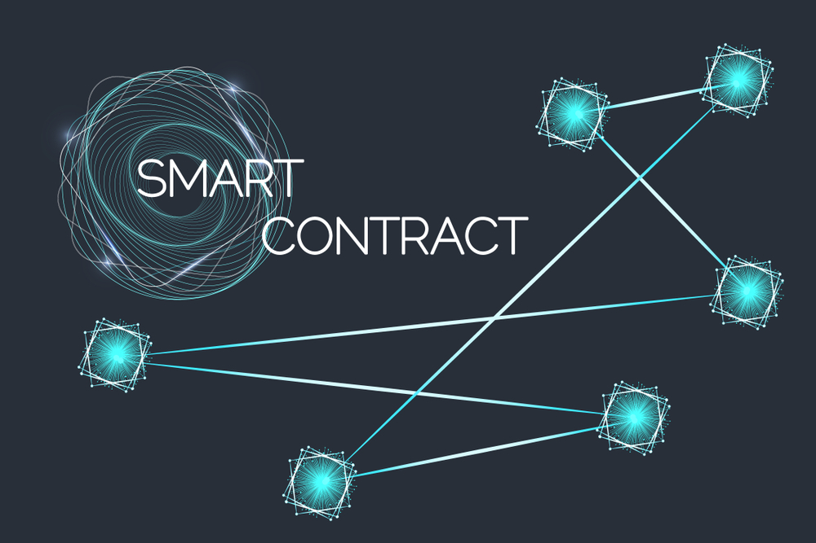
Security Architecture for IoT Devices and Data
IoT data is signed at the device, encrypted in transit, validated via smart contracts, and its hash anchored on-chain while bulk data is stored off-chain. This provides authenticity, confidentiality, and immutability without overloading the blockchain.
Device Level Security
Each IoT device gets a unique cryptographic identity (public/private key pair).
Data packets are digitally signed by the device using its private key so the blockchain can verify authenticity.
Data Encryption
In transit: Encrypt all communication using TLS/SSL to prevent interception.
At rest (before blockchain): Sensitive data (like GPS, owner info) is encrypted before storage in off-chain databases.
Hashing & Integrity Proofs
Compute a hash of the IoT data payload.
Store the hash (or Merkle root if batching) on the blockchain while raw data sits in a world state DB or relational DB.
Smart Contract Verification
1. Check that the submitting IoT device is registered and active.
2. Check that the signature matches the device’s public key stored on-chain.
3. Check that the data fits into expected ranges.
Network-Level Security
1. Use secure gateways between IoT devices , compress, and validate data
before blockchain submission.
DID assigned – public key
Public/private key pair assigned
Device generates sensor data (e.g., CO₂ = 415 ppm).
transaction
MQTT with TLS\SSL Support
Edge gateway signs, filters, or encrypts the data.
decentralized identity
& verifiable credentials
Cloud gateway aggregates multiple devices/sources.
Cloud gateway runs a blockchain client (Fabric SDK, etc.).
submits a transaction to the blockchain that triggers the smart contract.
Smart contract validates the IoT device identity with public key and stores the data (or hash) immutably
AWS IoT Core
MS Azure
Google Cloud
transaction
Format data for
blockchain transaction
transaction
Smart contract call from cloud gateway
Perform
steps
3 and 4
transaction
Fabric Blockchain
World State
Relational DB

Slide 50
Data Integration Security Architecture
Supply Chain IOT -> Edge Device
MQTT is the selected protocol as it has high efficiency, natively supports pub/sub for asynchronous data transfer. In addition, security is
configured with TLS support, and it can have up to QoS0-2 (exactly once data transfer guarantee).
Edge Device -> API Gateway -> Microservices Application
HTTPS REST is to be utilized due to its standardization and ubiquitous ecosystem. Has been associated with ease of implementation.

Slide 51
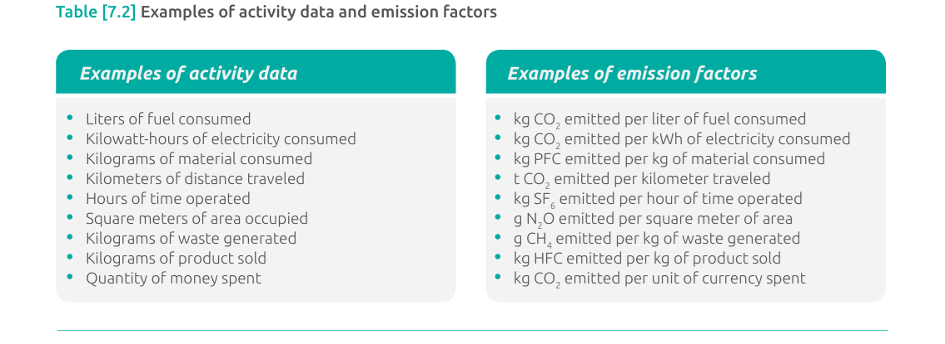
Scope 3 Value Chain Accounting and Reporting Standard
Input emissions must be tied to the Scope
Global warming potential (GWP) values Global warming potential (GWP) values describe the radiative forcing impact (or degree of harm to the atmosphere) of one unit of a given GHG relative to one unit of carbon dioxide. GWP values convert GHG emissions data for non-CO2 gases into units of carbon dioxide equivalent (CO2 e). Companies should use GWP values provided by the Intergovernmental Panel on Climate Change (IPCC) based on a 100-year time horizon. Companies may either use the IPCC GWP values agreed to by United Nations Framework Convention on Climate Change (UNFCCC) or the most recent GWP values published by the IPCC. Companies should use consistent GWP values across their scope 1, scope 2, and scope 3 inventory and should maintain consistency in the source of GWP values used over time (by consistently following guidance provided by either the UNFCCC or IPCC, once selected). Companies that have already developed scope 1 and scope 2 GHG inventories should use the same GWP values for scope 3 to maintain consistency across the scopes. Companies that have not previously developed a corporate GHG inventory should use the most recent GWP values. Companies are required to disclose the source of GWP

Slide 52
Technical Architecture – Representation of the Digital Twin in a Smart Contract (1 of x)
Layered Blockchain Architecture Pattern
digital twin representation in a smart contract definition (pseudo code similar to Solidity)
┌──────────────────────────────┐
│ Application Layer │ ◄── UI, APIs, microservices
├──────────────────────────────┤
│ Integration Layer │ ◄── Adapters, SDKs, event brokers
├──────────────────────────────┤
│ Smart Contract Layer │ ◄── Chaincode / EVM contracts
├──────────────────────────────┤
│ Consensus Layer │ ◄── PBFT, Raft, PoS, etc.
├──────────────────────────────┤
│ Network Layer │ ◄── P2P communication
├──────────────────────────────┤
│ Data Layer │ ◄── Distributed ledger, Merkle trees
└──────────────────────────────┘
Layer | Key Tech / Tools | Purpose
Application | REST/gRPC APIs, Frontends, Orchestrators | Interfaces for end users and external systems
Integration | Kafka, gRPC, Fabric SDK, Event hubs | Bridges microservices to the blockchain
Smart Contracts | Solidity (EVM), Chaincode (Fabric/Go/TS) | Business logic written directly into the chain
Consensus | PBFT, Raft, PoW, PoS | Ensures all nodes agree on state
Network | libp2p, gRPC, gossipsub | Node communication & peer discovery
Data / Ledger | RocksDB, LevelDB, IPFS | Immutable event and state storage
ASK AI to write some 2 sentence blurb here…..

Slide 53
Technical Architecture – Function to Record Emission Data (3 of 3)
Example pseudo code representation for registering an IoT device on a blockchain. There are additional steps to be performed on the device itself prior to connection to the blockchain. Structures in a smart contract define these actions.
Here is the function to register the device on the blockchain.
a) create a unique identity using the IoT UUID or the device’s MAC address.
b) system controllers register devices using IoTDevice_register which includes the
, UUID, type, capabilities, and status.
2) The signature for the function to register is the following:
await contract.methods.registerDevice(
“some supplier Corp",
“UUID",
"CO2_Sensor",
"emissions_reporting",
"ipfs://example-data-link" ).send({ from: adminAddress });
- performed as a transaction to call this smart contract called “IoTDevices
- CALLED BY - IoT gateways or devices (via backend code using Web3.js, Web3.py,
Ethers.js, etc.)
What Happens on the Blockchain
a) The device info is stored immutably in the devices mapping
b) The device can be looked up on the blockchain via devices[“UUID”]
Security
a) If the policy is to allow anyone to register a device , remove the onlyAdmin
modifier.
contract IoTDevices {
function recordEmission( string memory _UUID,
uint256 _emissionValue,
string memory _units)
public { require(devices[_UUID].isActive, "Device not active or not
registered");
emissionsByDevice[_UUID].push(EmissionData({ UUID: _UUID,
timestamp: block.timestamp,
emissionValue: _emissionValue,
units: _units
}));
}
✅ Summary of What’s Needed
Component Purpose
EmissionData struct Stores a single data point
emissionsByDevice map Links UUID to array of emissions
registerDevice() Registers and activates a device
recordEmission() Logs a CO₂ value from an active device

Slide 54
A Quick Mention of “State Variables” and their Usage for the Digital Twin
State variables encapsulating the Supply Chain Net Zero Digital Twin are persisted on the blockchain ledger. These variables are programmatically created, modified, or removed through smart contract transactions as operational requirements evolve. They hold the contract’s data across transactions—similar to global variables in traditional programming—but they’re stored on-chain and are part of the blockchain's state.
State variables are:
Declared outside of functions.
Stored permanently in the contract's storage on the blockchain.
Updated only by transactions (calls that change state).
Writing/updating uses gas, accessible throughout the contract, can be public, private, internal or external.
Can not rely upon external data unless from the blockchain or oracle.
The following is the list of data classified and managed as “state variables”:
Supply chain digital twin configuration.
Supply chain segments
All greenhouse gas baselines associated with supply chain segments.
Greenhouse gas emission sources.
External emission measuring devices (IoT) registered on the blockchain.

Slide 55



Technical Architecture – Blockchain Definition of Digital Twin (1 of 3)
How is the Digital Twin Deployed on a Blockchain………
Digital Twins are represented as structures within a Smart Contract.
In Hyperledger Fabric:
- Smart Contracts are deployed on the blockchain through chaincode.
- A Smart Contract is identified through a combination of chaincode name, version,
package ID and Channel Name
- A Transaction Context Interface(ctx) is assigned to enable the smart contract to access
the blockchain ledger.
In Hyperledger Besu:
- Smart Contracts are deployed on the blockchain using Truffle, Remix or other
commercially available tools.
- An Ethereum-style contract address is generated. This address is derived from the
address of the account deploying the contract and the nonce (the number of
transactions sent from that account).
- The contract address is a 160-bit hexadecimal string (similar to an Ethereum account
address). Example: 0x5aB398F3A12c546bB6eF83087Ad2E933C87B3F21

Slide 56
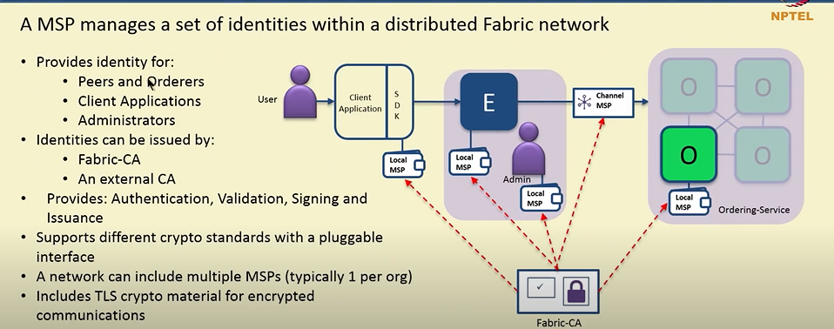
Membership and Identity Management for the NZDT Blockchain in Hyperledger Fabric
In Hyperledger Fabric, the Membership Service Provider (MSP) is a core component responsible for identity management and access control. It ensures that only authorized users and nodes can participate in the blockchain network.
Each supply chain participating organization has a Membership Service Provider(MSP). The MSP performs the following:
defines the boundaries of the fabric blockchain network
run 1 or more peers, orderers, clients
has an ID
contains a list of users and their roles and permissions within the network
has a keystore(private key for signing transactions
Signcert(Public x.509 certificate – will also define roles for a user)
Network can contain multiple organizations referred to as a Consortium Network defining the trust domain of an organization.
Each peer in the consortium network has a
channel where smart contracts exist.
Each peer within a channel has the same
smart contracts.
Each client application has a local MSP
to store user identities.
MSPs check CRLs(Certificate Revocation Lists)
to prevent compromised or invalid
certificates from participating in the network.

Slide 57
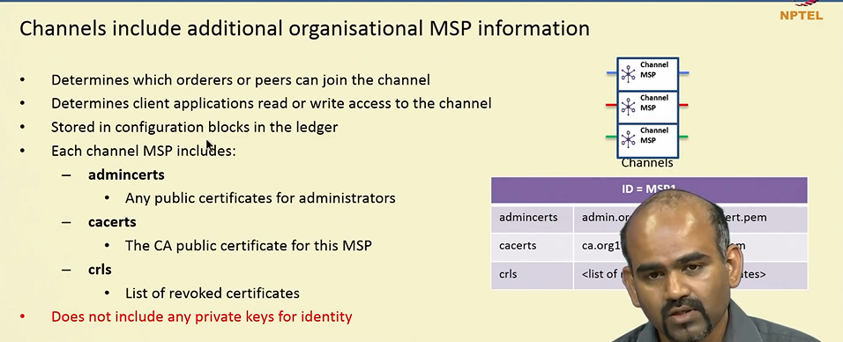
Collection of GHG Emissions Data and Privacy
A Hyperledger Fabric channel is a private communication layer — a logical partition — that allows a defined subset of network members to transact and view transactions privately on a shared distributed ledger.
Each channel maintains its own separate Ledger and Block Chain. It is referred to as the configuration block. This means transactions and state data for Channel A are completely independent from Channel B.
A Membership Service Provider (MSP) controls which organizations are members of a particular channel. Any node (peer) that is not a channel member will have no knowledge of transactions or state within it.
Configuration Block: Every channel starts with a genesis block, called a configuration block, which contains:
The list of participating organizations’ MSP IDs.
The policies for adding, removing members, or updating configuration
Channel-Specific Chaincode: Peers can install and approve chaincode separately for each channel, allowing different business logic and state to reside on each.
Design Benefit:
✅ Allows confidential transactions and data segmentation. ✅ Enables network participants to form specialized subsets or consortia without needing separate networks.
✅ Allows isolation of business relationships and workloads, reducing the risk of data leak, confusion, or policy violation.

Slide 58
Data Flow from IoT Device to Blockchain and/or Secondary Storage…..rewrite?
import paho.mqtt.client as mqtt
from web3 import Web3
# Initialize Web3 (for Ethereum)
w3 = Web3(Web3.HTTPProvider("http://blockchain-node:8545"))
contract = w3.eth.contract(address=CONTRACT_ADDR, abi=ABI)
def on_message(client, userdata, msg):
payload = json.loads(msg.payload.decode())
co2 = payload['co2_ppm']
device_id = payload['device_id']
tx = contract.functions.recordEmission(device_id, co2).build_transaction({
'from': SENDER_ADDRESS,
'nonce': w3.eth.get_transaction_count(SENDER_ADDRESS),
'gas': 100000,
'gasPrice': w3.to_wei('20', 'gwei'),
})
signed_tx = w3.eth.account.sign_transaction(tx, private_key=PRIVATE_KEY)
tx_hash = w3.eth.send_raw_transaction(signed_tx.rawTransaction)
print("Emission recorded, TX hash:", tx_hash.hex())
client = mqtt.Client()
client.on_message = on_message
client.connect("localhost", 1883)
client.subscribe("ghg/sensor")
client.loop_forever()
Example: JSON payload:
{
"device_id": "sensor-abc123",
"timestamp": "2025-05-08T12:00:00Z",
"co2_ppm": 412.8,
"location": "Factory-A"
}
Edge Device]
└─ Receives IoT data (e.g., via MQTT, USB, serial, etc.)
└─ Transforms data to contract-compatible format
└─ Uses SDK or RPC to connect to blockchain node
└─ Builds + signs transaction
└─ Submits transaction to blockchain node (peer or RPC node)
Transaction Creation: The edge device creates a transaction or message containing the processed data and metadata (like the device's identity and other relevant information).
API Gateway and Data Validation: The edge device uses an HTTP API gateway to send the transaction to a centralized API gateway. This gateway verifies the transaction's validity, including the signature, firmware, and Merkle tree proof stored on the blockchain.
Blockchain Integration:Once validated, the transaction is sent to the blockchain network, where a smart contract can access and process the data.

Slide 59
Process View – How the Digital Twin Compares Planned vs Actual
Emissions Baseline Entry
Transactions - Emissions Entry
Real-Time Emissions Tracking
Each company/firm enters its GHG emission baseline value(s) as transactions for its supply chain segment. Represents planned total emissions in this segment.
First, a blockchain transaction deploys chaincode containing the smart contract with an ID.
The smart contract will maintain state variables on the blockchain holding the baseline values for the company/firm.
The baseline emissions numeric value is placed in the digital twin blockchain as a transaction placing this value into the state variable.
Example of the state variable:
struct { ID string,
company string format,
baseline decimal format,
baseline_unit string, (ex: emission/mile)
runtime_total decimal format,
supplychainSegment_ID string format }
Digital Twin Peer Hyperledger Fabric Node
Continuous comparison against the baseline
plan as emission data arrive from the source.
Key: The emissions baseline value is derived from model and scenario analysis capability of the digital twin.
Company X is an organization approved through MSP to send transactions to this blockchain.
channel: digital-twin
Block: n+ 1
Block: n+ 2
Latest Block
Supply chain
seg 1 baseline value
Supply chain
seg 2 baseline value
Supply chain
seg 3 baseline value
Real-Time Comparison:
compares the expected emissions for the supply chain segment against planned (baseline)
state variable(a): baseline/expected emissions
state variable(b) : emission running total
Deviation from plan = state variable(b) –
state variable(a):
get emission baseline values for supply chain segments
get emission baseline values for supply chain segments
At the start of the supply chain GHG emission baselines for a company are collected from the blockchain. Baselines and state variables represent expected emissions for that particular portion of the supply chain(i.e. truck, boat, original manufacturer).
As emissions data are collected they are placed into the blockchain as transactions in real-time.
A transaction calls a smart contract to place emission data for a company into the next block.
Company emissions data are collected real-time and compared against expected emission per mile, or time, or other metric.
Real-Time Reporting:
Report status on current emissions for the segment of the supply chain tracked.
Hyperledger Explorer (Dashboard)
send alerts and display on interactive dashboard
Use AI for analysis and remediation strategy.
Alert GHG emission specialists on any abnormal emissions for analysis and strategy.

Slide 60
Transaction Processing of GHG Emissions Data in Real Time(addition of data)
Hyperledger Fabric Sequence of Steps for Data Collection and Storage
Key: When a peer connects to a channel, its digital certificate identifies its owning organization via a channel MSP.
An application initiates a transaction request to blockchain by sending the data through an API. Note: can be a digital thread collecting data.
The transaction request has a “Context” that identifies a “Smart Contract” to perform business logic.
A Smart Contract can perform the following:
1) Store data “on-chain” as entries into the Fabric blockchain
2) Store data “off-chain” into other storage such as IPFS
3) Update “State Variables” representing “totals”, “averages”
and/or values. For example, the running total of GHG
emissions is computed within the logic of the smart
contract and managed within the code. These
variables are not stored in the blockchain.
“Off-Chain” storage is an option related to very
high volumes of data received in real time.
Storing data “off-chain” involves hashing the
data held in the off-chain system and then
transmitting the hash to the Fabric
blockchain as a reference to the data.
Each data feed to the blockchain has
its own “Smart Contract” defined.
AI-Driven “Smart Contracts” are
integrated to an AI engine
allowing for the recognition
of patterns for
recommendations.
Company A is an organization approved through MSP to send transactions to this blockchain.
Simplified View
data -> transaction request
IPFS
IPFS
Digital Twin Peer Hyperledger Fabric Node
IPFS
B
Block: 1
Blockhash : 1
………
Smart contract stored on blockchain
Block: 2
Blockhash : 2
………
Block: 3
called by transaction request
places data into a transaction for storage into blockchain
updates all “state variables”
starts process to ‘validate” this transaction
data storage options include on-chain and off-chain
“state variables” contain GHG emission running totals
AI-Driven enables “smart contracts” to have AI capability
Blockhash : 3
………
Block: n
Blockhash : n
xxDB
File hash to blockchain
………
xxDB
“off-chain storage to IPFS”
file hash to blockchain
“off-chain storage to DB”
send data to AI engine
AI-Driven
Smart Contract
deliver predictions / strategy
Company B is an organization approved through MSP to send transactions to this blockchain channel.
data to emission report systems
data -> transaction request
channel: digital-twin

Slide 61
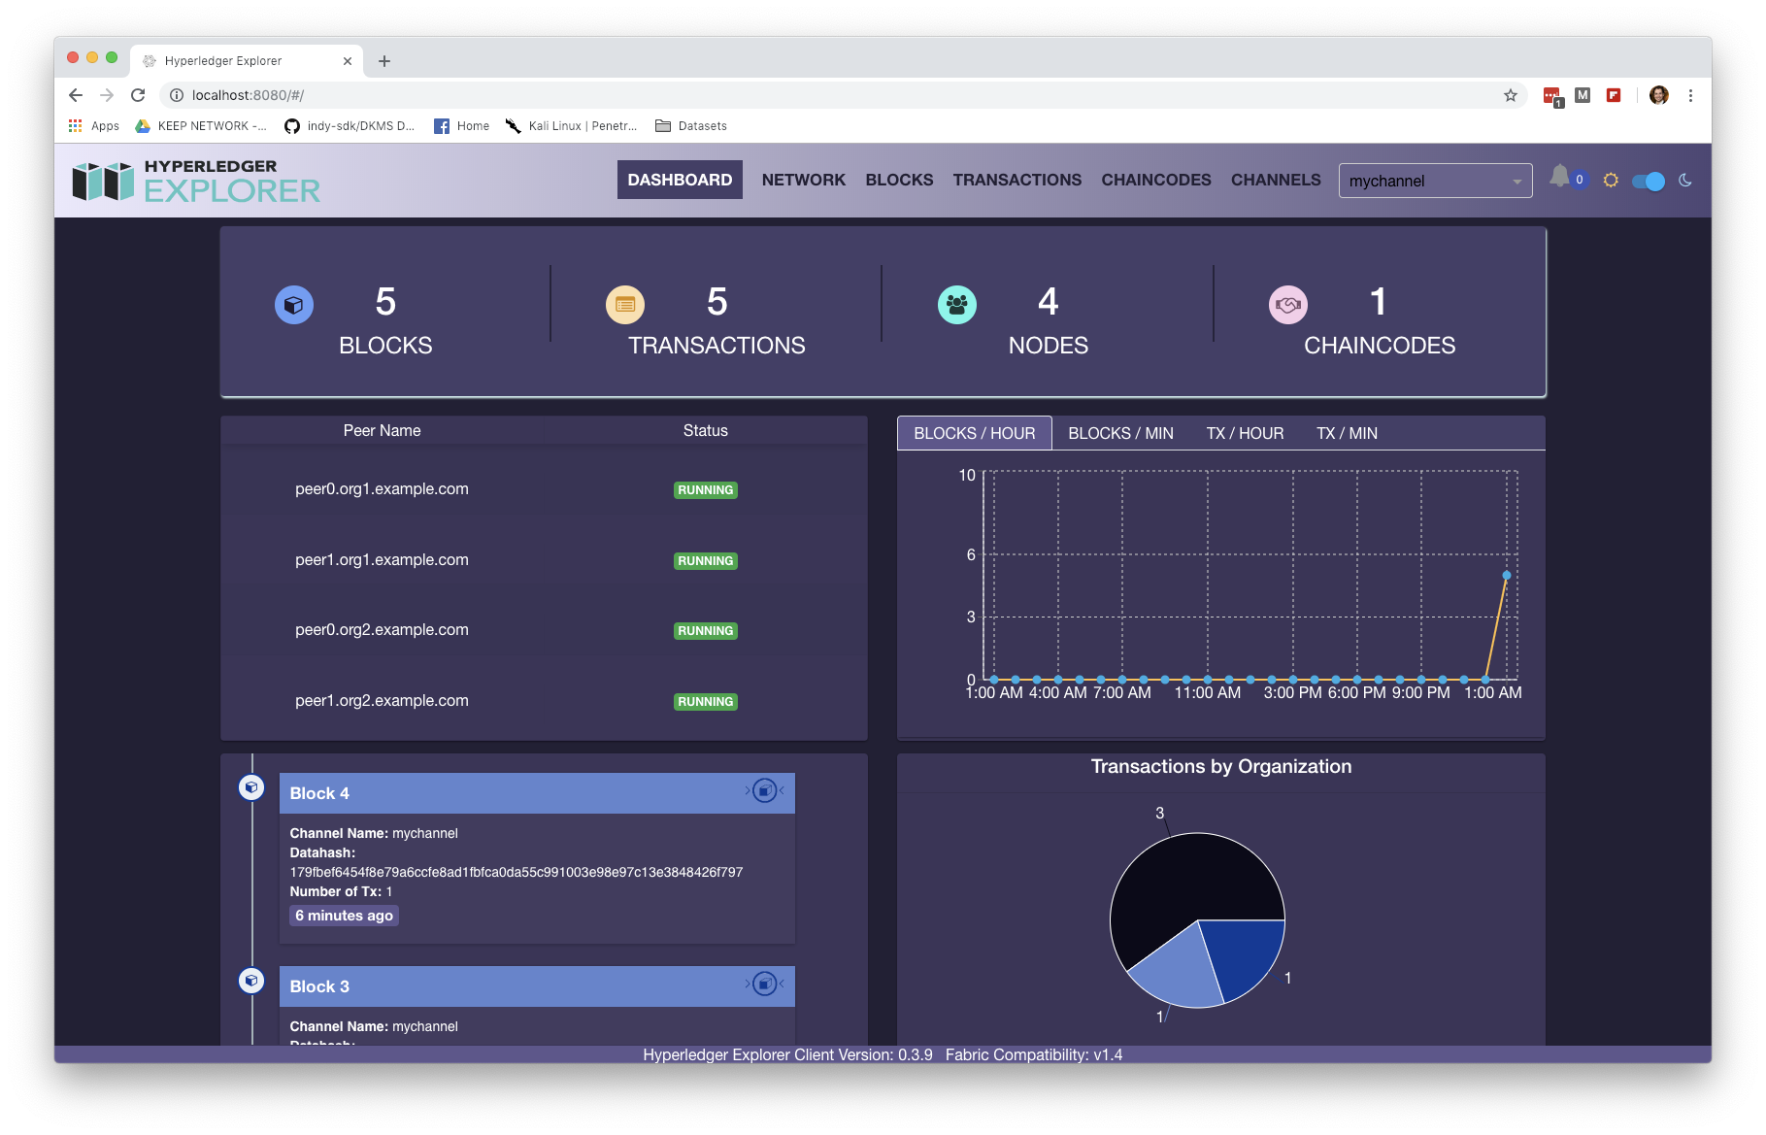
Business View - Digital Twin GHG Emission Monitoring
Monitor, Report Deviations, and Remediate Emissions
An application initiates a transaction for the following:
1. store an emissions baseline value representing the
expected GHG emissions for a segment of the supply
chain(or entire chain).
2. manual or electronic entry of data representing the
amount of emissions over a time period.
A smart contract is called to perform the following:
1.) build a transaction to store the data point on the Fabric
blockchain. If data are to be stored “off-chain” send them
to this location.
2. update “state variable” which is a running total of
emissions for the segment of the supply chain.
Smart Contract retrieves emission baselines for each defined segment of the supply chain.
Process for emissions tracking in real-time
1. as emission values arrive, subtract from the baseline to
determine if rate of emissions is as expected.
2. provide real-time information to the tracking dashboard.
Smart Contract provides Hyperledger Explorer most up to date
information to show emissions as the supply chain is in
operation.
Any deviation from the emission plan results in these options:
1. alerts to GHG emissions accounting specialists and/or
management. Alerts may not be needed if the purpose is
to only measure current emissions across the supply
chain.
2. utilize AI to track related data(ex. Traffic) that impacts
emissions to enable remediation strategy.
Company A is an organization approved through MSP to send transactions to this blockchain.
GHG Emissions Tracking View
1
1
data -> transaction request
channel: digital-twin
2
Digital Twin Peer Hyperledger Fabric Node
Block: n+ 1
Block: n+ 2
Block: n+ 3
Latest Block
2
Supply chain
seg 1 baseline value
Supply chain
seg 2 baseline value
Supply chain
seg 3 baseline value
Supply chain
seg 4 baseline value
3
get emission baseline values for supply chain segments
get emission baseline values for supply chain segments
get emission baseline values for supply chain segments
3
smart contract collects data in real time, creates a transaction to place data in the next block
GHG emission baselines are collected from the blockchain. Baselines and state variables represent expected emissions for that particular portion of the supply chain(i.e. truck, boat, original manufacturer).
at the start of the supply chain, emissions data are collected real-time and compared against expected emission per mile, or time, or other metric.
4
4
Track GHG Emissions and Report /
state variable: baseline/expected emissions
state variable : emission running total
5
Real Time Tracking of GHG Emission(s) against Baseline
- report status on current emissions for the segment of the
supply chain tracked
- send alerts and display on interactive dashboard
Smart Contract
5
6
Hyperledger Explorer (Dashboard)
Use AI for analysis and remediation strategy.
Alert GHG emission specialists on any abnormal emissions for analysis
and strategy.
6

Slide 62


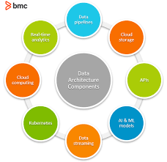
Data Architecture
And
Ontology

Slide 63
Data Architecture Knowledge Graph (1 of 3)
A digital twin will typically have to interact with a combination of climate/environmental accounting protocols, standards, and methodologies. To facilitate consistent data handling and accounting across these different protocols, standards and methodologies, the digital twin can utilize the AIA Ontology developed by LFDT’s Climate Action and Accounting SIG “Standards Working Group”.
Several types of protocols, standards and methodologies are used in the environmental impact / GHG accounting space:
1. Measurement collection standards: These are standards for measuring aspects of activities and processes. They focus on how the measurements are made, and concern things like the calibration and correct use of instruments. Application of these standards produce valid and trustworthy measurement data.
Calculation methodologies and data processing standards: These are guidelines and standards for the transformation, evaluation and aggregation of data and metadata. Their application produces indicators, metrics and indices with well-defined meanings.
Reporting standards: These concern how claims or assertions about entities or activities, such as a report on the yearly emissions of a company, are made. Application of these standards yield reports of a targeted degree of depth, completeness, clarity and transparency.
Verification standards or verification protocols: These concern the process of verifying a claim made by another entity regarding their compliance with some other standard. Their application produce certifications or assurance.
Protocols, standards and methodologies are created by many different organizations and regulatory bodies. These entities have different priorities and concerns, and often use different terms for the same things. The purpose of the AIA Ontology is to enable data and accounting systems to translate between and aggregate across these different focus areas and terminologies.
AIA stands for “Anthropogenic Impact Accounting”

Slide 64
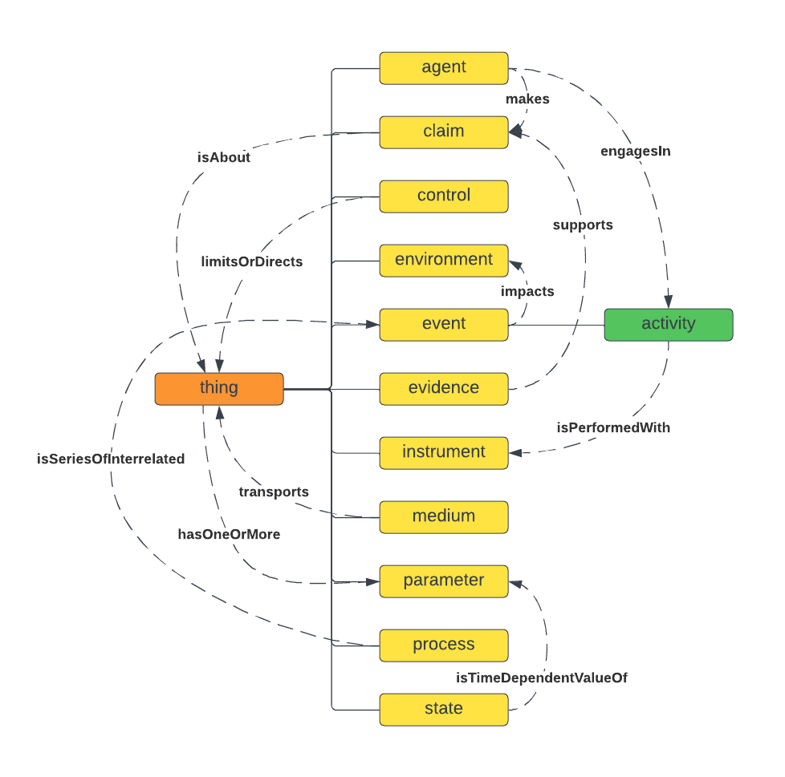
Data Architecture Knowledge Graph – Data Sets (2 of 3)
Utilizing the aforementioned Standards WG data ontology as a model, a knowledge graph for the digital twin has been produced.
process (supply chain)
has
hasAggregateBaseline
activity (segments)
Owns/operates
hasBaseline
agent
makes
claim
engagesin
isAbout
baseline (state)
hasImpact
isSeriesofInterrelated
hasNetZeroTarget
thing
environment
impacts
hasRole
event
activity
hasCalcs
control
isPerformedWith
hasMeasurementSystem
Calcs
Formula
ismodelledtoNetZero
instrument
digitaltwinproduces
parameter
isSetofOperatingParms
modelssupplychain
representing

Slide 65
Data Architecture Knowledge Graph (3 of 3)
The classes and axioms to derive the digital twin ontology are detailed below. The Standards WG ontology is the model.
Classes:
process : supply chain
activity: supply chain segments(number) and function/purpose
agent: owns activities and makes claim on scope 1, 2 emissions
for their supply chain segment.
claim : made by an agent about a
- claim:identity_claim(describe the supply chain)
- claim:state_claim (condition of truck, motors, cranes)
- claim:impact_claim(change to solar energy in warehouse+others)
control : state
state : baseline (generated during modeling)
- control:calculation_formula(IoT measures&calcs)
- control:measurement_system (IoT format specification)
- control:objective (net zero model)
- control:role:calibrator, owner, verifier, auditor(IoT devices and
manual entry)
environment : impacts global atmosphere
event: emission over a specified time frame
event :measuring, monitoring, calculating
Instrument: IOT, truck, vessel, warehouse heater, cooling etc. (above control class)
Medium :
parameter: defines bounds of supply chain operations
representing: digital twin model of physical state, performs
emission modeling , (supply chain segments?), can model
baseline to net zero emissions
process (supply chain)
has
hasAggregateBaseline
activity (segments)
Owns/operates
hasBaseline
agent
makes
claim
engagesin
isAbout
baseline (state)
hasImpact
derived from
isSeriesofInterrelated
thing
hasNetZeroTarget
environment
impacts
hasRole
event
activity
hasCalcs
control
isPerformedWith
hasMeasurementSystem
Calcs
Formula
ismodelledtoNetZero
instrument
digitaltwinproduces
parameter
isSetofOperatingParms
modelssupplychain
representing

Slide 66
Data Architecture – IoT Data Storage Issue
Storing all IoT data readings directly on a blockchain can be expensive and inefficient, particularly when dealing with the high volume and velocity of data typically generated by IoT devices. Several factors contribute to this expense:
1. Storage Costs:
Blockchain Storage: Blockchain networks, including Hyperledger Fabric, require every participating node to maintain a copy of the entire
ledger. Storing vast amounts of IoT data on-chain increases the size of the blockchain significantly, which in turn raises the storage
requirements for each node.
Data Redundancy: Since blockchains are decentralized, the same data is replicated across many nodes. This redundancy ensures data
integrity and availability, but it also multiplies storage costs.
2. Transaction Costs:
Transaction Fees: On some blockchains, especially public ones like Ethereum, every transaction incurs a fee (known as gas in Ethereum). High-frequency IoT
data would lead to numerous transactions, potentially resulting in significant costs.
Resource Consumption: Processing large volumes of IoT data transactions consumes network resources (CPU, memory, bandwidth) on the blockchain nodes,
potentially leading to increased operational costs.
3. Latency and Throughput:
Scalability Limitations: Most blockchain networks have limited throughput and higher latency compared to traditional databases. Storing IoT data directly
on-chain can create bottlenecks, as blockchain networks may struggle to keep up with the data flow from IoT devices.
Real-Time Constraints: Blockchain transactions often require consensus, which introduces latency. This can be problematic for IoT applications that require
real-time or near-real-time processing.
4. Data Volume and Frequency:
High Data Volume: IoT devices generate massive amounts of data, often in the form of small, frequent updates. Storing every single reading on-chain would
result in an enormous amount of data, much of which may be redundant or unnecessary for long-term storage.
Data Retention: Not all IoT data needs to be retained
Conclusion: While storing all IoT data directly on a blockchain is technically feasible, it is not cost-effective or practical for most applications due to high storage, transaction, and operational costs. Instead, a hybrid approach that leverages off-chain storage and selective on-chain data anchoring is often used to balance the benefits of blockchain (e.g., security, traceability) with the practical constraints of handling large-scale IoT data.

Slide 67
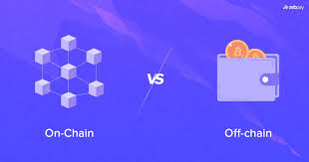
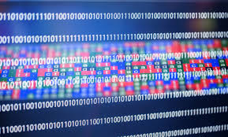


Data Architecture – IoT Data Storage Solutions
Solution 1: (https://pinata.cloud/blog/off-chain-storage-for-web3/)
Off-Chain Storage with On-Chain References: Store large volumes of IoT data off-chain (e.g., in a traditional database, cloud storage, or
distributed file system like IPFS) and only store cryptographic hashes or metadata on-chain. This approach ensures data integrity and
traceability while keeping the blockchain lightweight.
Solution 2:
Selective Data Storage: Only store critical or summary IoT data on the blockchain. For example, store only data points that trigger specific
events, meet certain thresholds, or are relevant for audits. This reduces the amount of data stored on-chain while still ensuring the security
and integrity of important information.
Solution 3:
Data Aggregation and Compression: Aggregate or compress IoT data before storing it on the blockchain. For instance, instead of storing
every single sensor reading, store aggregated statistics (e.g., hourly averages, maximum and minimum values) or compressed data that
summarizes the raw data.
Solution 4:
Use of Layer 2 Solutions: Implement Layer 2 solutions (e.g., state channels, sidechains) that allow for high-frequency transactions to occur
off the main blockchain, with only final results or occasional snapshots recorded on-chain. This reduces the burden on the main network.
Solution 5:
Edge Computing: Perform initial data processing, filtering, and decision-making at the edge (close to where the IoT data is generated) to
reduce the amount of data that needs to be transmitted to the blockchain.

Slide 68
Ed Cheng : Solution and Technical Architecture Design Work Plan(1)
Data integration Design
Design Process:
Review the “Requirements” spreadsheet with a focus on “non-functional requirements” in the categories of Integration, Performance, and API.
Review PowerPoint slides containing a high-level description on how data(manual, IoT driven) is to be used in the application.
Define an overall data integration strategy :
- determine the architecture pattern* as it applies to data integration to the Net Zero digital twin blockchain.
- for example: microservices, event driven API, monolithic
- research best practice used in existing blockchain implementations
- design of high velocity real-time data capture
- impact on data integration if hosted “in-house” or a commercial hosting service(Amazon, MS Azure)
- detail how the IoT “payload” will be structured for acceptance
Use of “external sources:
- any AI assistant (NOTE: AI engines are roughly one year out of date)
- any search engine
- GitHub
Define and design how the data integration strategy meets the following:
- expandability / maintainability, performance / reliability, security
Investigation into the Open Source LFDT products
- which LFDT products are best choice
Documentation
- Need to discuss best location for the design details (another powerpoint, text documents with drawing capability?)
* Architecture pattern is defined as the high level overall approach such as monolithic, microservices, event-driven, serverless.

Slide 69
Ed Cheng : Solution and Technical Architecture Design Work Plan(2)
Permissioned Blockchain Design
Process:
Review the “Requirements” spreadsheet with a focus on “Blockchain” in the categories of hosting, SC, smartcontract.
Review PowerPoint slides containing a high-level description of how data(manual, IoT driven) is to be used in the application.
Design Focus – Blockchain Transactions :
- smart contract code on the blockchain
- store data on the blockchain (baseline values, IoT devices) and high volume data in the World State database
- the format(fields) of a transaction
Design Focus – Smart Contracts :
- what business functions are the smart contracts to perform?
- is there a need for a consensus model?
- how are emission baseline values managed, register IoT devices
- design behavior of STATE VARIABLES
Use of “external sources for designing this section of the architecture:
- any AI assistant (NOTE: AI engines are roughly one year out of date)
- any search engine
- GitHub
Define
- user blockchain access, data security, IMMUTABILITY OF THE DATA , server (node) hosting strategy,
Investigation into the Open Source LFDT products
- which LFDT products are best choice
Documentation
- Need to discuss best location for the design details (another powerpoint, text documents with drawing capability?)

Slide 70
Ed Cheng : Solution and Technical Architecture Design Work Plan(3)
Data Management and Data Security
Process:
The spreadsheet tab entitled “Requirements” in the categories of blockchain, data management, integration, storage is the focus.
Review PowerPoint slides containing a high-level description on how data(manual, IoT driven) is to be used in the application.
Focus on the following :
- data security associated with accepting data from IoT (or other) mechanical devices
- use of digital certificates and key pairs
- L2 and/or “off chain storage” decision and design
- hash data stored “off-chain”
- format for data stored “on-chain”
- process to manage/capture high velocity data streams
- transactions store GHG emission baselines and emission model runs
Use of “external sources:
- any AI assistant (NOTE: AI engines are roughly one year out of date)
- any search engine
- GitHub
Define and design how data management and data security meets the following:
- expandability of data fields/ maintainability, performance, auditability
Investigation into the Open Source LFDT products
- which LFDT products are best choice
Documentation
- Need to discuss best location for the design details (another powerpoint, text documents with drawing capability?)
* Architecture pattern is defined as the high level overall approach such as monolithic, microservices, event-driven, serverless.

Slide 71
Ed Cheng : Solution and Technical Architecture Design Work Plan(4)
Application Integration
Definition:
Process:
The spreadsheet tab entitled “Requirements” in the categories of blockchain, data management, integration, storage is the focus.
Review PowerPoint slides containing a high-level description on how data(manual, IoT driven) is to be used in the application.
Focus on the following :
- application access to the blockchain – entire process for secure access
- data security associated with accepting data from IoT (or other) mechanical devices
- use of digital certificates and key pairs
- L2 and/or “off chain storage” decision and design
-
-
Use of “external sources:
- any AI assistant (NOTE: AI engines are roughly one year out of date)
- any search engine
- GitHub
Define and design how data management and data security meets the following:
- expandability / maintainability, performance / reliability, security, IMMUTABILITY OF THE DATA
Investigation into the Open Source LFDT products
- which LFDT products are best choice
Documentation
- Need to discuss best location for the design details (another powerpoint, text documents with drawing capability?)
* Architecture pattern is defined as the high level overall approach such as monolithic, microservices, event-driven, serverless.

Slide 72
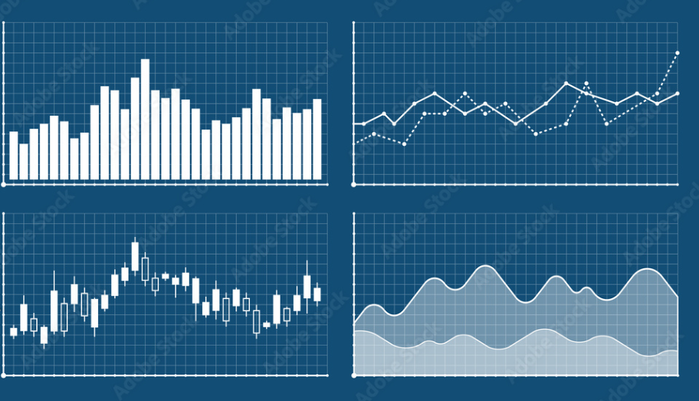
Supply Chain Loading Ops(Grower) Trucking UnloOps
Supply Chain
Truck Load(grower)
Trucking
Unloading
Warehouse
Grinding OPS
Loading Ocean Vessel
Unload at NY Harbor
Repack OPS
Historical Charts (ghg emissions)
Planned
Total ghg emissions
Last SC Run
Total ghg emissions
5,234
(kg co2E)
8,234
(kg co2E)
Supply Chains in Progress
Started
2025-04-11 10:34:12
Started
2025-04-13 09:23:09
Completed
42%
Completed
13%
Sample Dashboard – Users can configure the dashboard into a format needed.
Historical emissions data can be displayed to observe trends.
GHG emission parameters to display are selected buy the users. The entire dashboard can be modified through drag and drop.
Total Emissions to This Point
1864.12 kg co2 E
Total Emissions to This Point
464.12 kg co2 E
Stage
Unloading at Warehouse
Stage
Truck to Warehouse

Slide 73
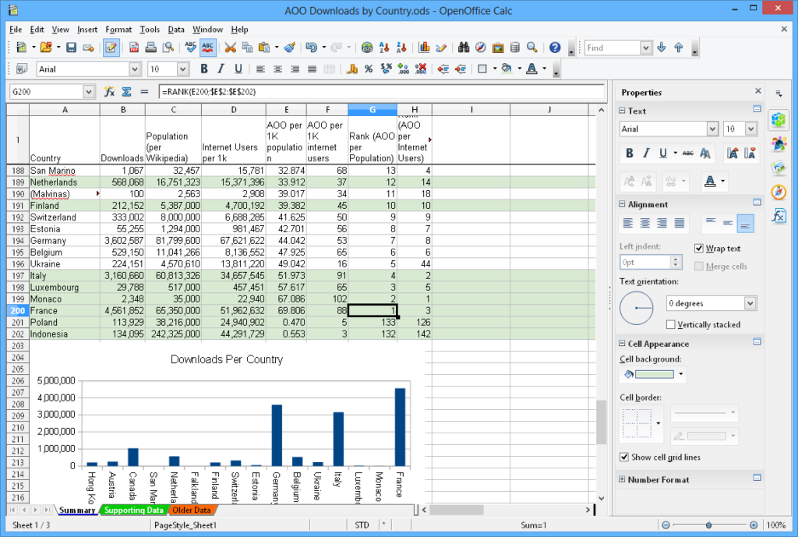
press for detail on supply chain segment
Supply Chain Loading Ops(Grower) Trucking UnloOps
Supply Chain
Truck Load(grower)
Trucking
Unloading
Warehouse
Grinding OPS
Loading Ocean Vessel
Unload at NY Harbor
Repack OPS
Supply Chain Segment : Truck Beans to Coffee Warehouse
In Progress
Budgeted
Transport Information
In ProgressTransport Detail | Distance | Expect Time
Truck Toute Total Miles | 864 km | 5.2 hours
Total Miles Driven | 363 km | 3.2 hours
Total Remaining | 501 km | 3.1 hours
Started
2025-04-13 10:34:12
Current Time
2025-04-14 01:55:12
Completed
42%
Completed
42%
History of ghg emissions for this segment
Budgeted Emissions to ThisPoint
101.12 kg co2 E
Actuals in real time:
Total Emissions to This Point
94.84 kg co2 E
Status : - 6.28 kg co2 E
Planned
Total ghg emissions for this Supply Chain Segment
235.64
(kg co2E)

Slide 74
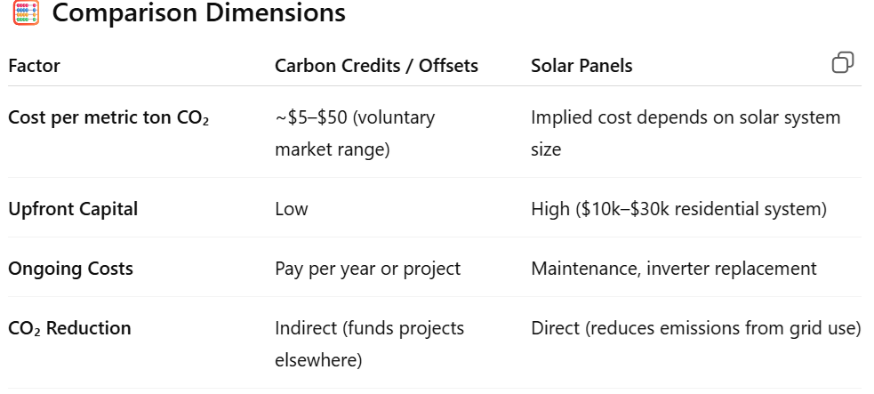
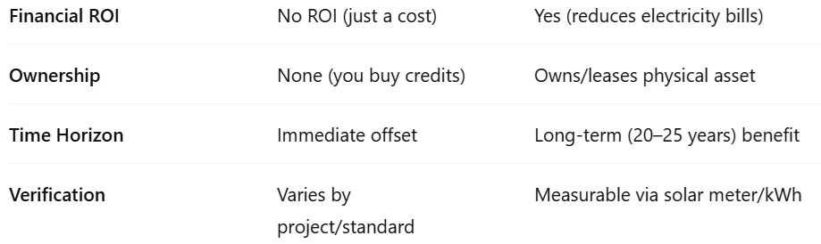
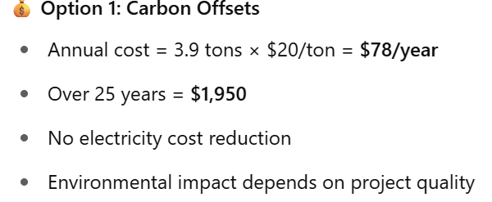
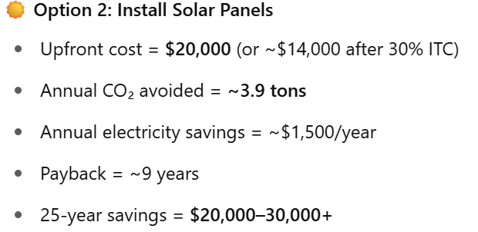
Digital Twin for GHG Emission Modeling of the Supply Chain - AI Assisted Options
Truck Load(grower)
Truck to Warehouse
Unloading
Warehouse Storage
Warehouse Grinding OPS
Loading
Ocean Vessel
Unload at
NY Harbor
Repack OPS
Cloud Hosting
Supply Chain #19946 – Model GHG Reduction of the Warehouse
input to LLM (ChatGPT)
Perform a comparative analysis between the purchase of carbon credits/offsets vs. installing solar panels to reduce carbon emissions associated with a storage warehouse.
Current Emission Baseline
AI Emission Reduction Strategies
New Emission Baseline
LLM Output (ChatGPT)
Warehouse ops (mtons CO2/yr)
Based on the input question 3 GHG emission reduction strategies are recommended.
Warehouse ops (mtons CO2/yr)
D
Heating
- air
- water
- drying
- humidity control
Heating
- air
- water
- drying
- humidity control
Reduce New
11.2
1) solar panels
Select
10.1
1.1
1.5
1.5
0.0
5.4
5.4
0.0
0.3
2) credit market
Select
0.3
0.0
Cooling
- air
- humidity
- water
3) roof composition
Select
Cooling
- air
- humidity
- water
24.2
14.0
10.2
2.3
Press the “Select” button to enter details on changes made to the warehouse to reduce GHG emissions. Enter new emission values.
2.2
0.1
0.3
0.3
0.0
Total = 45.2
Totals 33.8 11.4
Report
Carbon credit cost($) = 1,352
% Emission Reduction = 74.8
Solar install cost($) = 0.0

